Slide 1
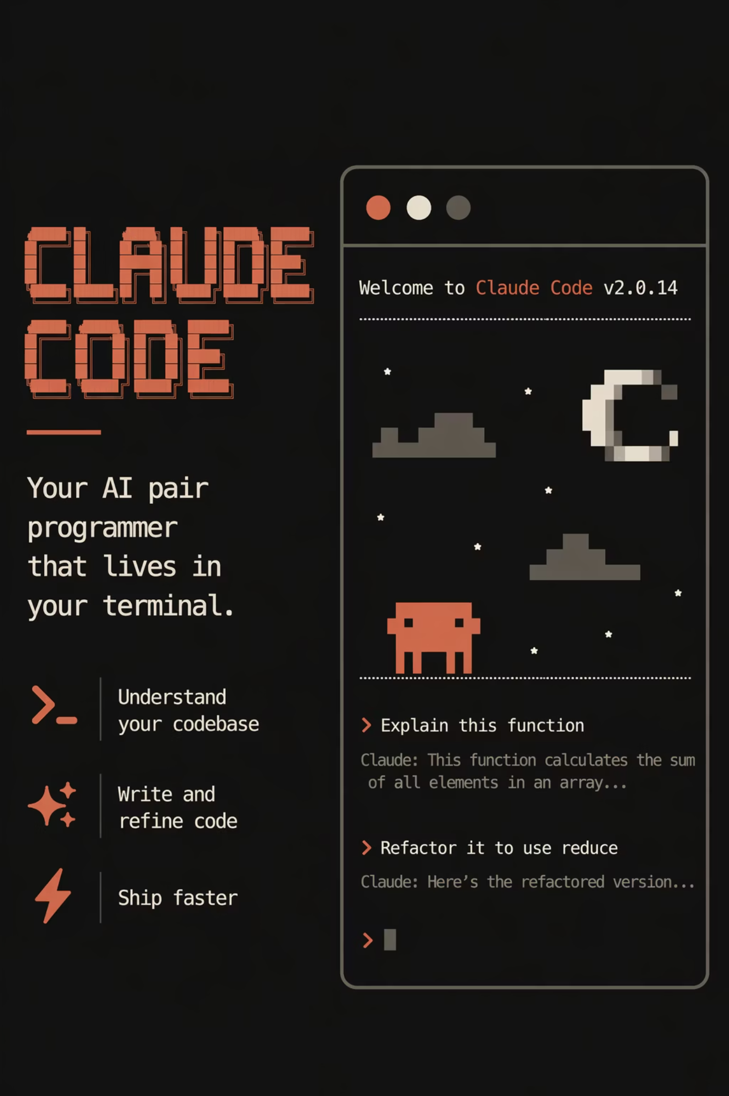

Claude Code for Experts
Ivan Dachev

Slide 2
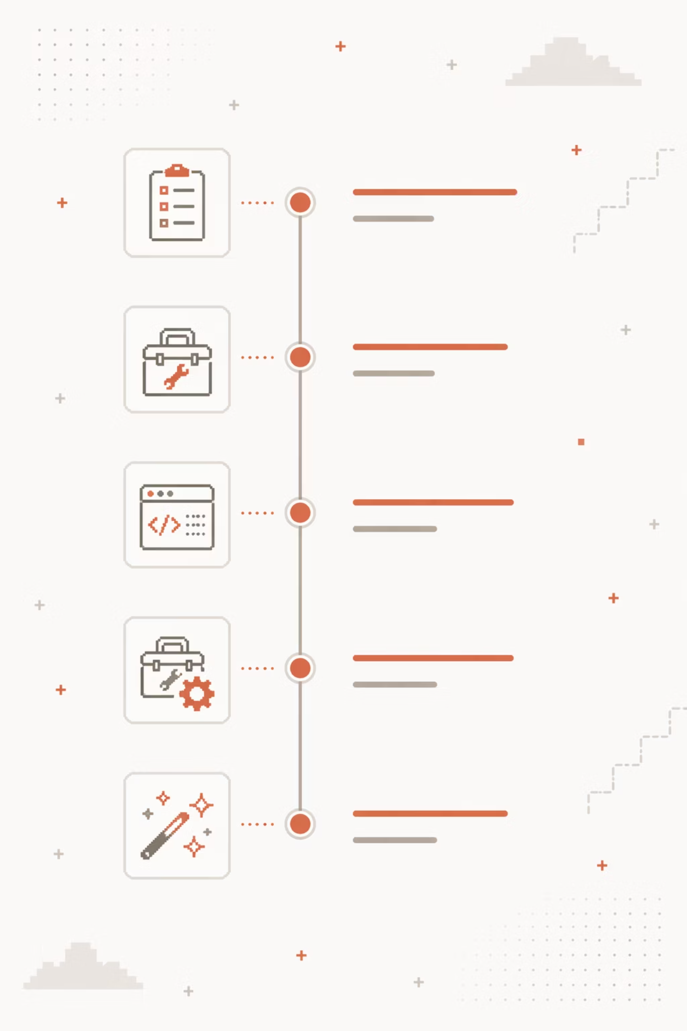
Agenda
Available Toolbox
Coding Workflow
More Hacks

Slide 3
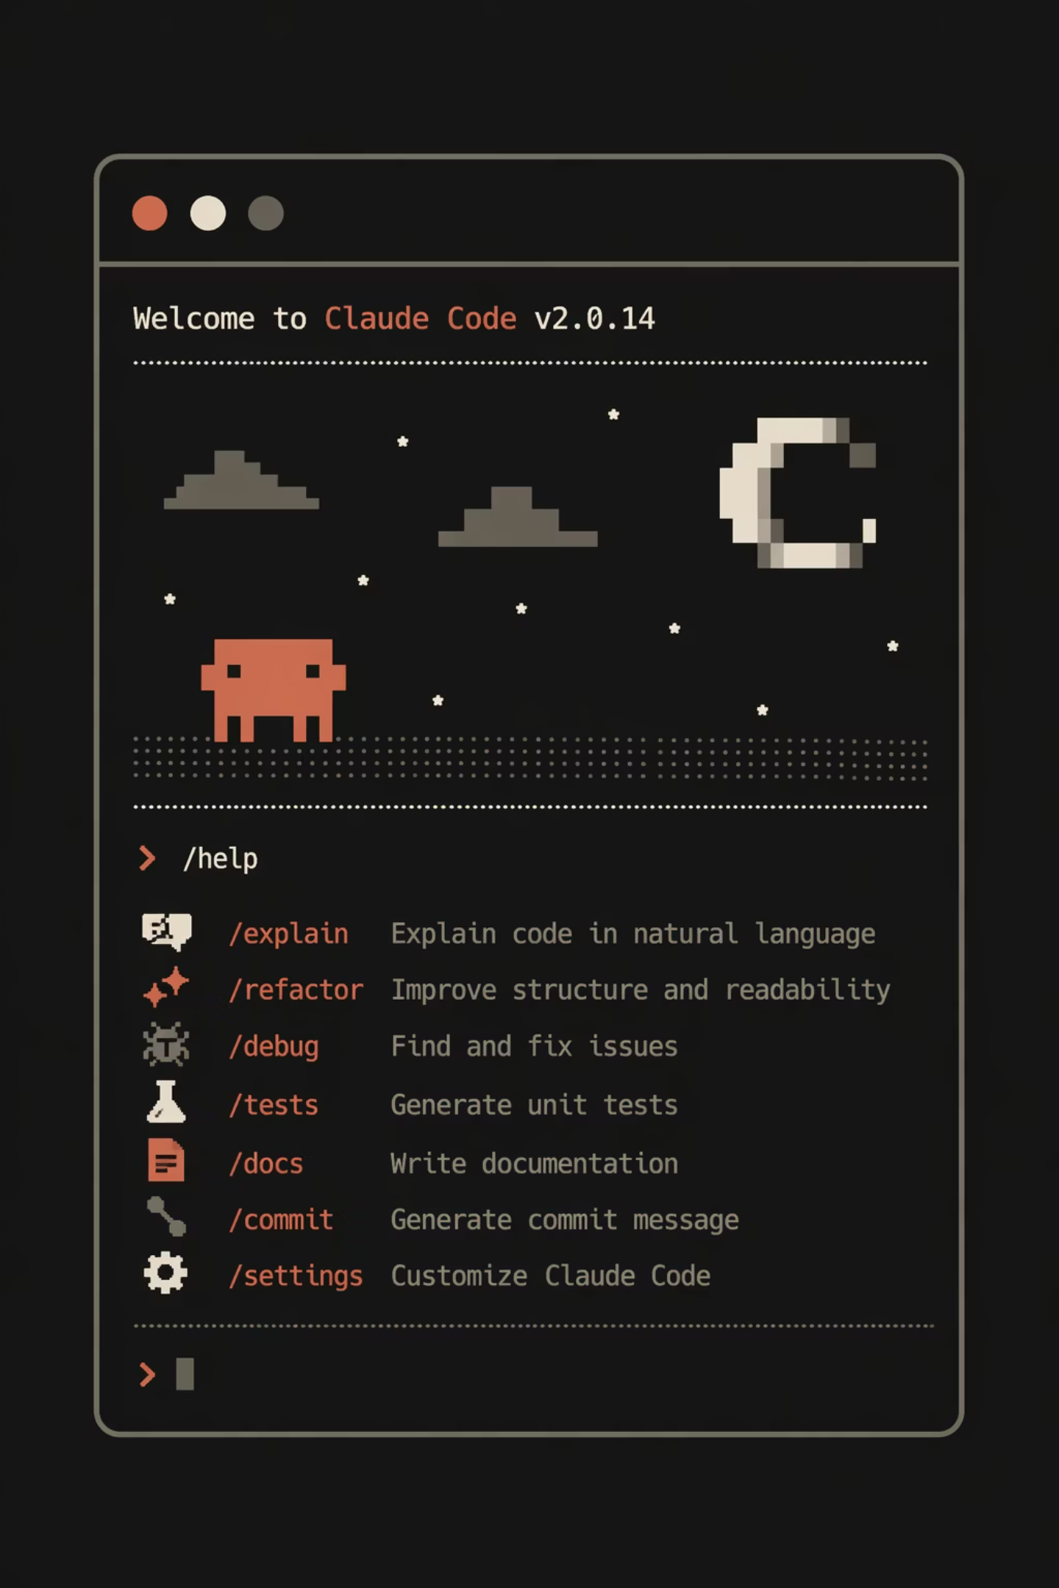

Toolbox
Agents & Skills/Rules
MCP Servers
Plugins & Marketplace
Context Management
Notes:
Skills/Rules from build in and Claude Code official repo.Useful MCP servers:
https://github.com/vercel-labs/agent-browserhttps://www.claudedirectory.org/plugins/playwrighthttps://www.atlassian.com/platform/remote-mcp-server
Using superpowers

Slide 4
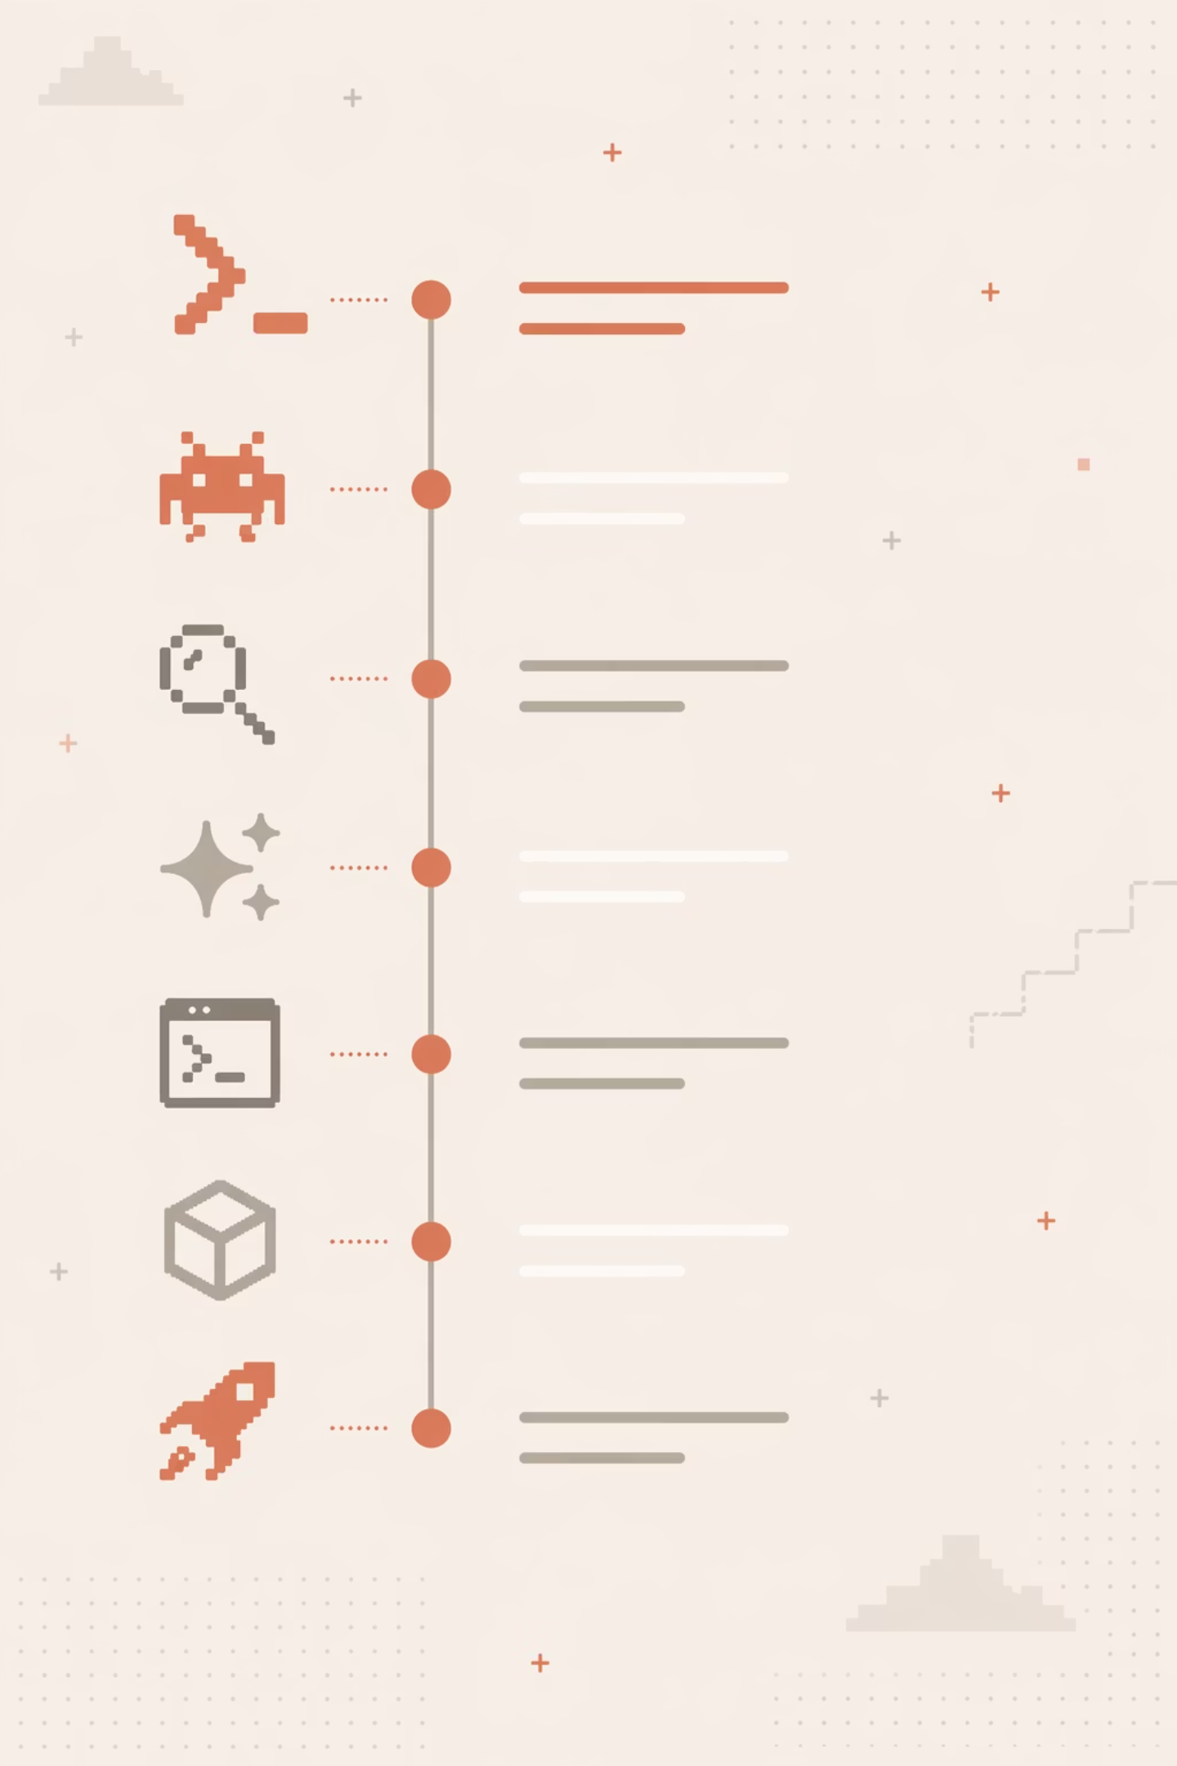
and More
Terminal Hacks
Hooks & Status Line
Task Organization
Workflow Orchestration

Slide 5
Agents: From Chat to
Autonomous Development
Plan → Code → Review → Refine
Parallel Sub Agents
Contextual Awareness
Tasks Execution

Slide 6
Skills/Rules
Reusable Playbooks
Auto-loaded
or
Slash-invoked
Bundled +
Custom + Community
Notes:
What it is
Newest way to extend Claude Code
Like an onboarding guide for a new engineer
A folder with SKILL.md + optional scripts, templates, docs
How it works
Claude reads the description up front
Matches request → loads full skill into context
Progressive disclosure — no context cost until used
Two invocation modes
Auto-invoked (Claude decides)
Explicit (/skill-name)
Ecosystem
Bundled skills from Anthropic (debug, batch, etc.)
Community skills on GitHub (anthropics/skills) + 3rd-party registries
The key win
Write once, reuse everywhere
No more pasting standards into every chat
Whole team's Claude Code picks it up
YAML frontmatter — the essentials
Identity: name, description, when_to_use
Invocation control: disable-model-invocation, user-invocable, paths
Arguments: arguments, argument-hint
Execution: allowed-tools, model, effort, shell
Subagent: context: fork, agent
Lifecycle: hooks
Only description is truly recommended — rest is optional
Closer
Minimal skill = just name + description + instructions

Slide 7
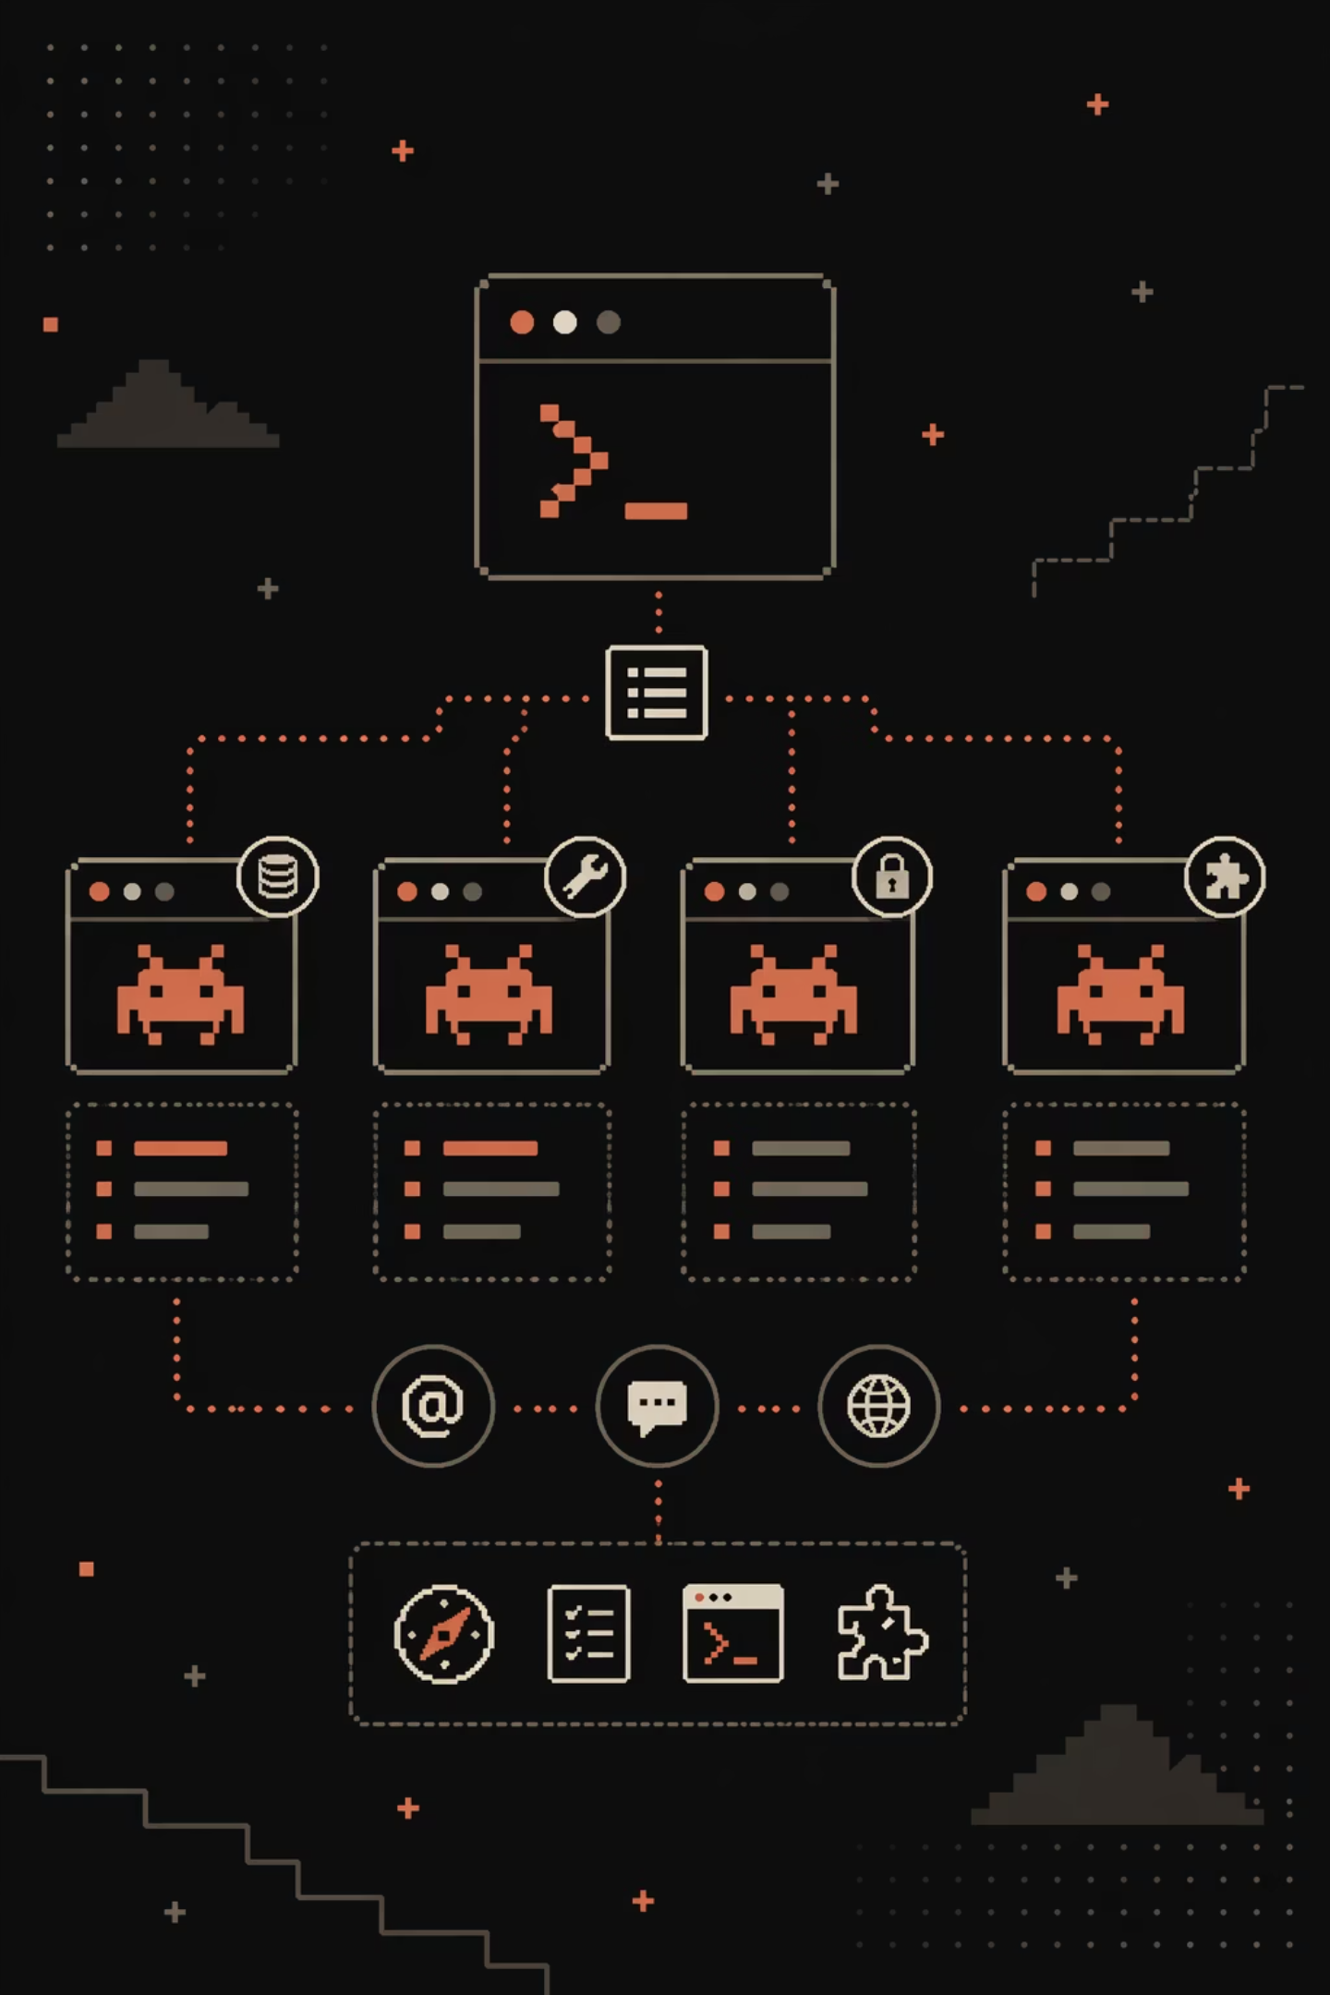
Subagents
Isolated context
Custom prompt, Tools,
Self permissions
Auto-delegated, Session-wide
Built-in +
Custom + Plugins
Notes:
What they are
Specialized assistants for specific task types
Each runs in its own context window
Custom system prompt, tool access, permissions
Markdown file + YAML frontmatter in .claude/agents/
Why they matter
Preserve context — verbose output stays out of main chat
Enforce constraints — limit tools, permissions per agent
Specialize behavior — focused prompts per domain
Control costs — route cheap tasks to Haiku
Built-in agents
Explore — read-only, Haiku, fast codebase search
Plan — research during plan mode
general-purpose — full toolkit, multi-step work
Three ways to invoke
Auto — Claude delegates based on description
Explicit — @agent-name mention
Session-wide — claude --agent <name>
Foreground vs background
Foreground blocks main chat; background runs concurrent
Ctrl+B to background a running task
Superpowers
Preload skills into agents (skills: field)
Persistent memory across sessions (memory: user/project/local)
Scoped MCP servers (keep tools out of main context)
Lifecycle hooks (PreToolUse, PostToolUse, SubagentStop)
Frontmatter essentials (only name + description required)
Identity: name, description
Tools: tools, disallowedTools
Model: model, effort
Permissions: permissionMode, maxTurns
Context: skills, mcpServers, memory, isolation
Lifecycle: hooks, background, initialPrompt
Skills vs Subagents (the key distinction)
Skill = knowledge injected into main chat
Subagent = isolated worker that returns a summary
Skills when you need context; subagents when you don't
Closer
Minimal agent = name + description + system prompt
Best for verbose, self-contained tasks that return a summary

Slide 8

Coding Workflow

Slide 9




Plan
Code
Refine
Review
Notes:
Here we’re not just showing a development cycle — we’re showing a feedback system.
Claude Code follows a Plan → Code → Review → Refine loop, but the key differentiator is what happens in the Refine phase.
During Review, we identify issues — not just bugs, but also poor decisions, missing constraints, or unclear assumptions. Then in Refine, we don’t just fix the code — we update the system itself.
This includes improving the agent’s Skills, refining available commands, and updating the CLAUDE.md file, which acts as persistent guidance for future executions.
Over time, this creates a self-learning loop. Every mistake becomes a rule. Every issue improves future behavior.
So instead of repeatedly making the same mistakes, the agent evolves — becoming more aligned, more predictable, and more effective with each iteration.

Slide 10
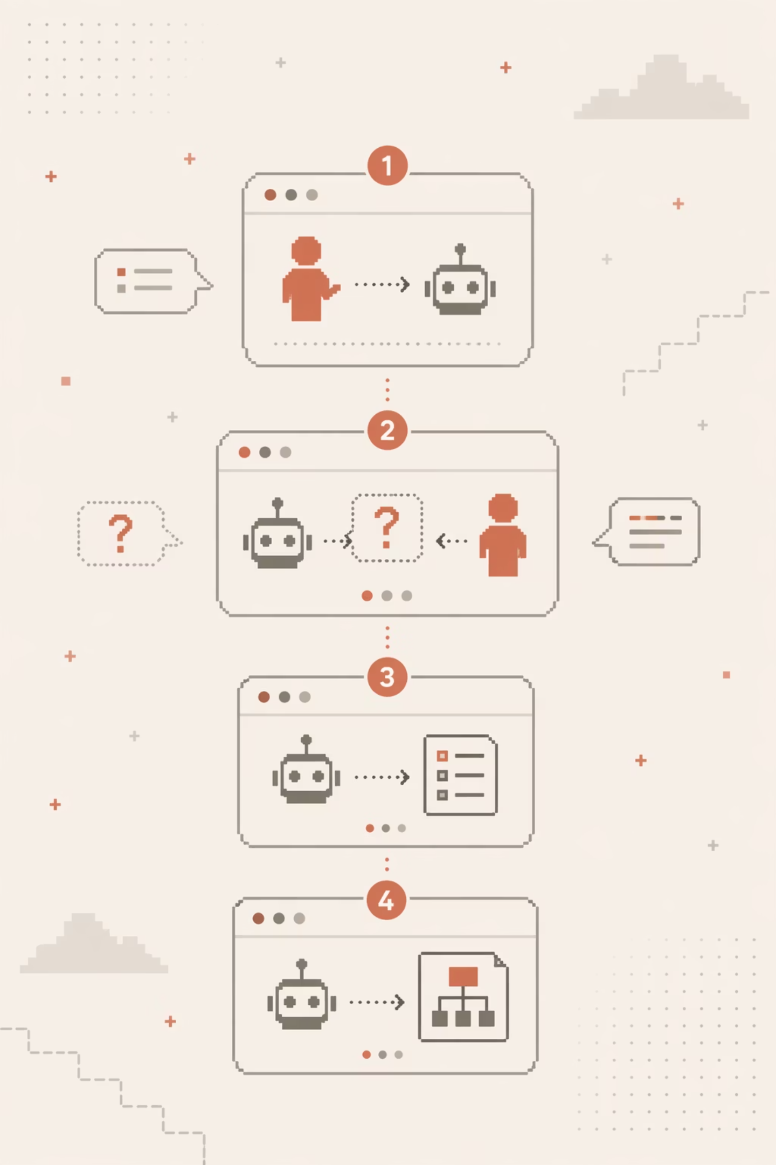
Plan Creation
Human Gives Agent a Task
Agent Asks - Human Answers Open Questions
Agent Builds Initial Plan
Agent do
Self Review

Slide 11
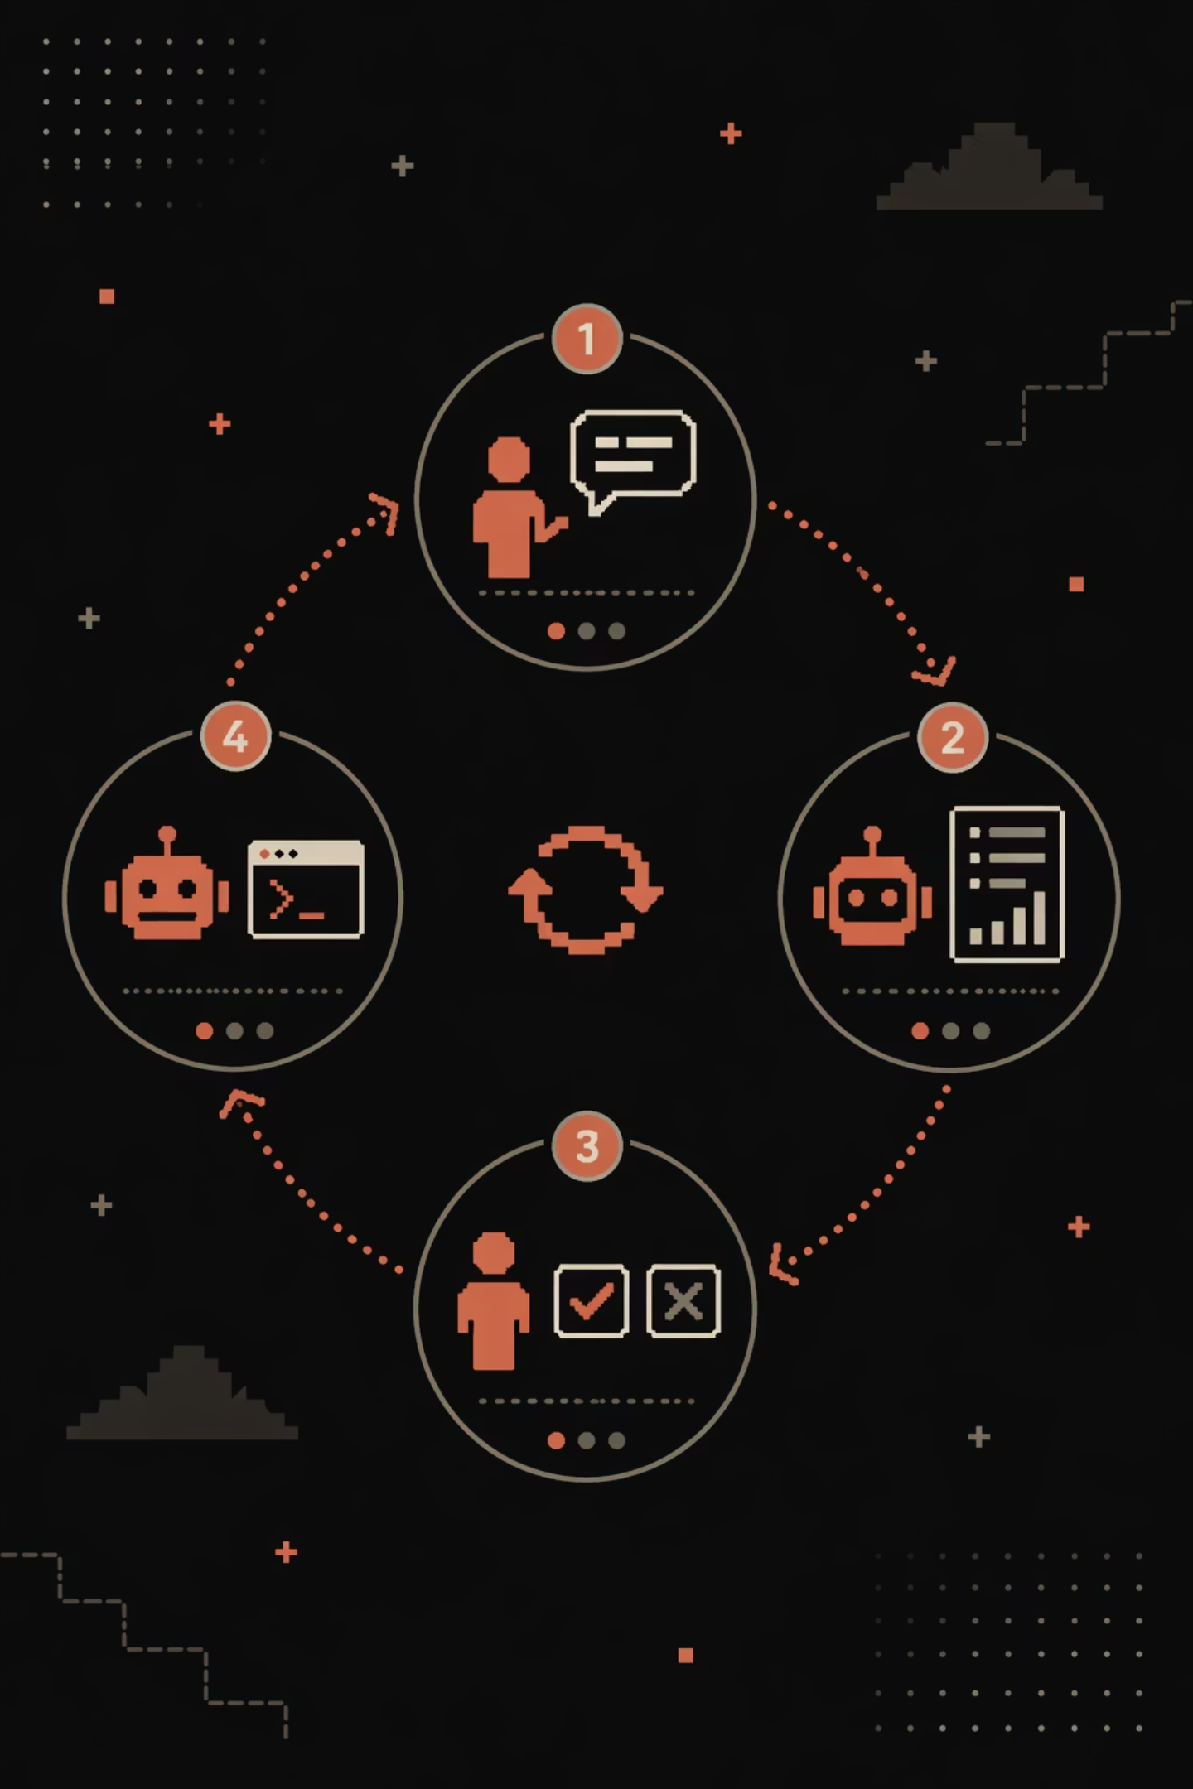




Plan Review
Human Instructs Review
AI Shows Findings
AI Fixes Issues
Human Decides

Slide 12
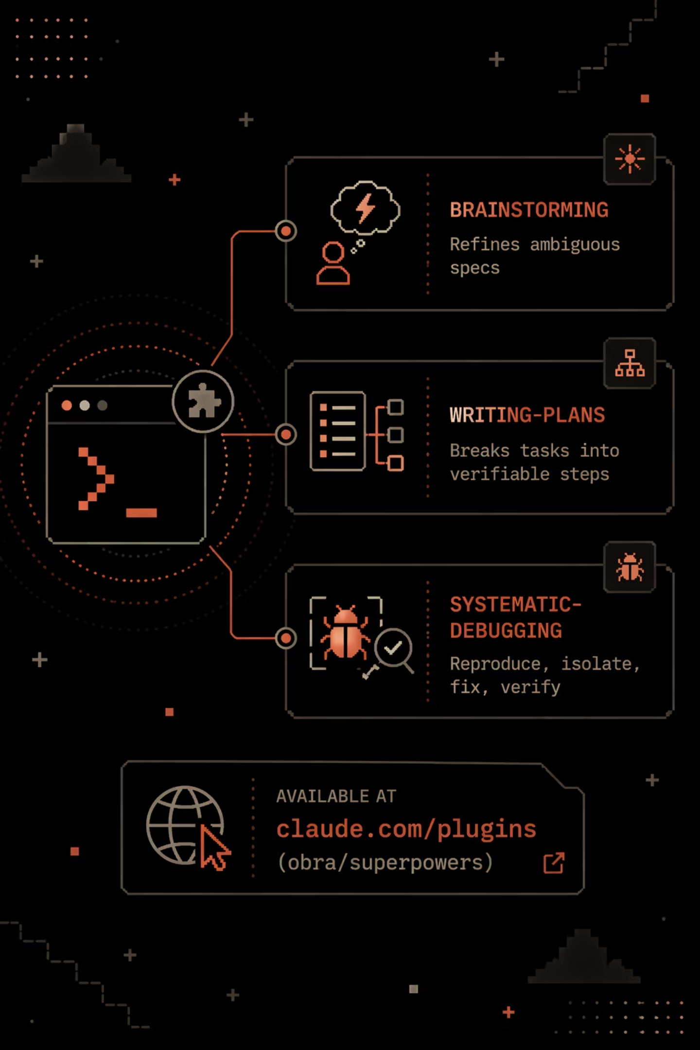
Superpowers
Brainstorming
Writing-Plans
Systematic-Debugging
Notes:
https://claude.com/plugins/superpowers

Slide 13
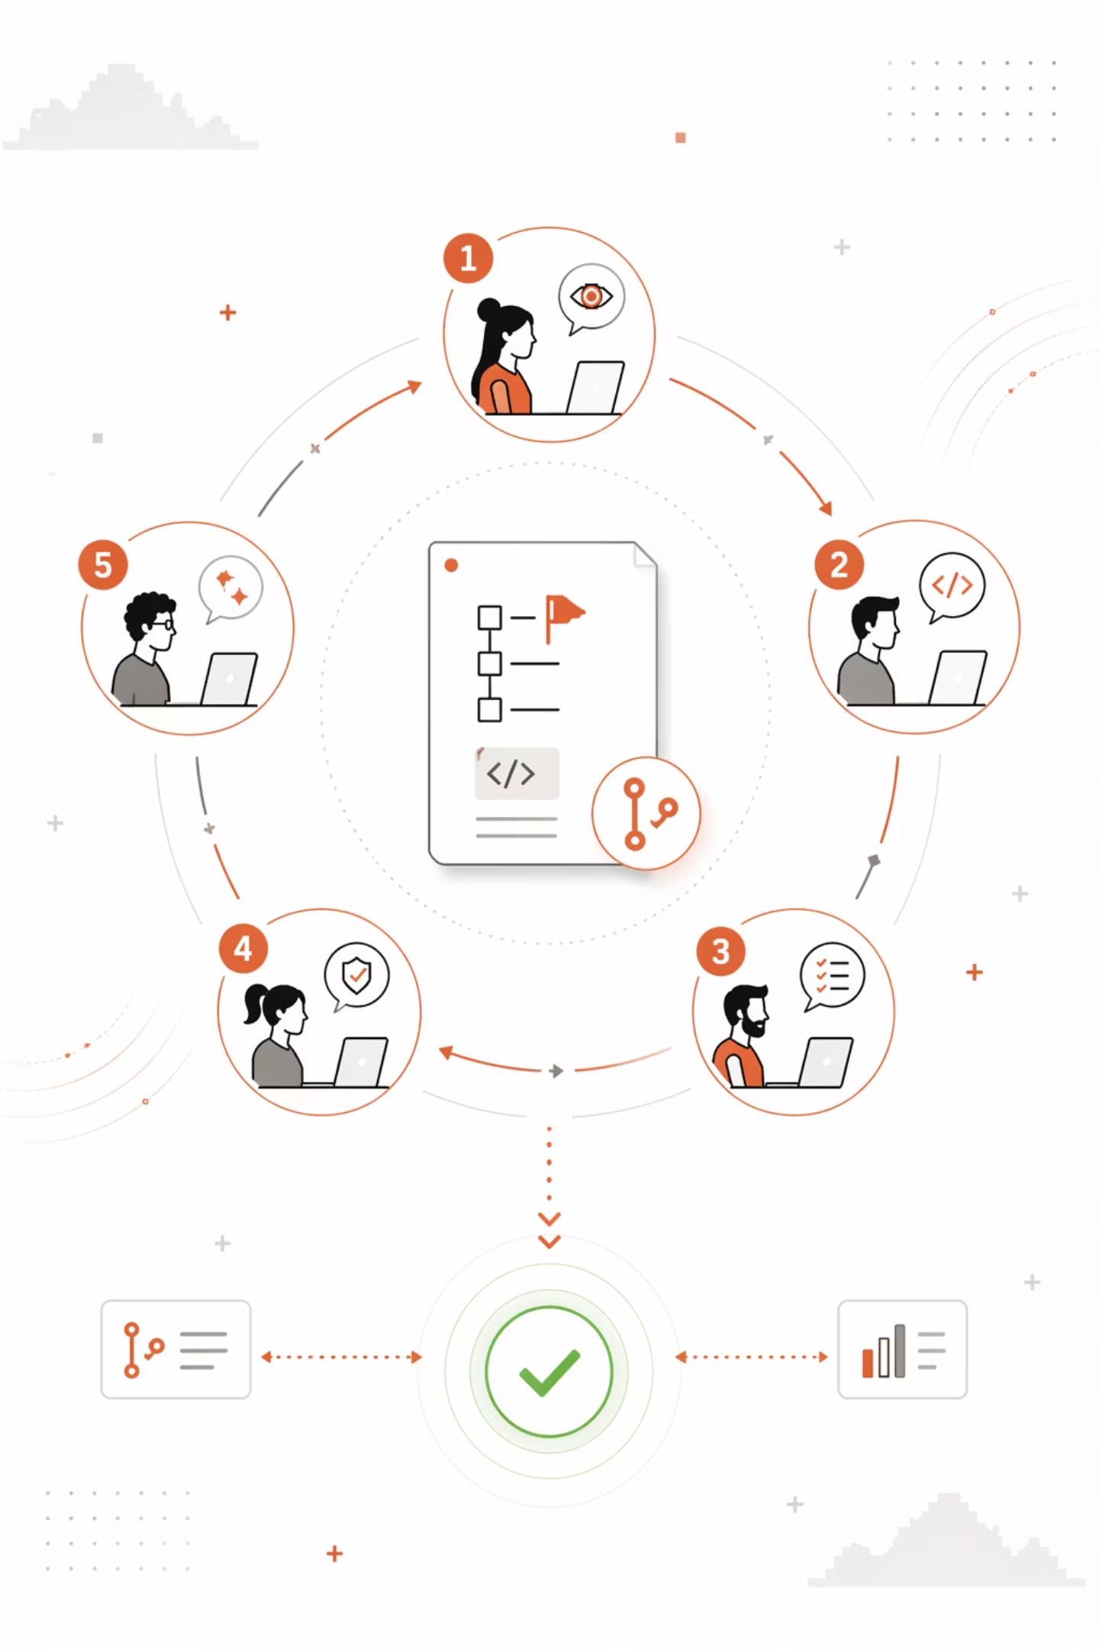
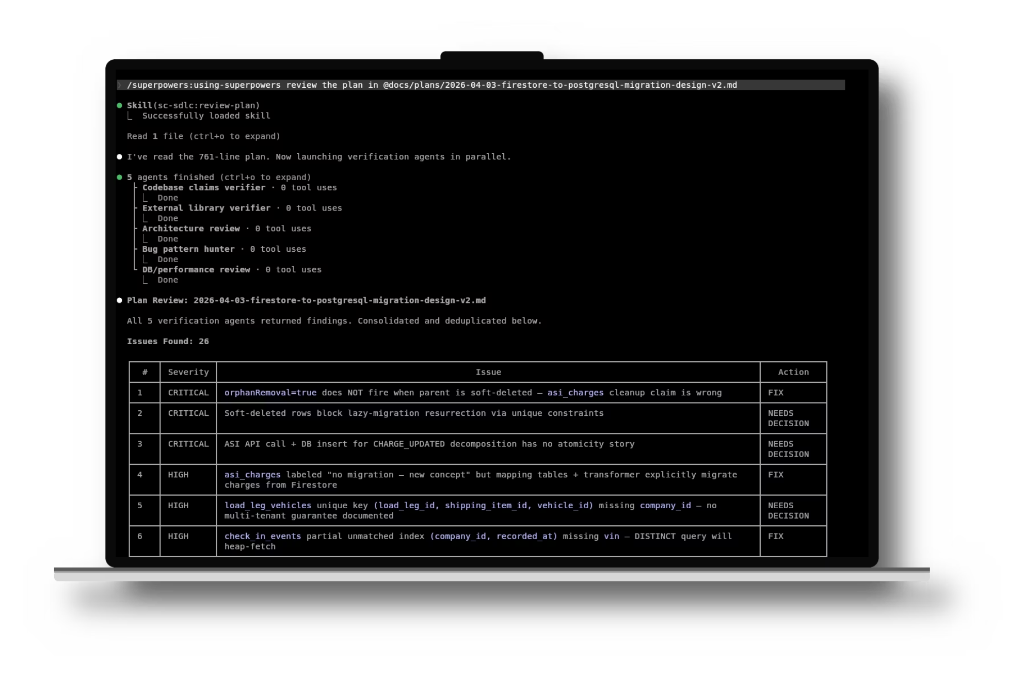

Slide 14
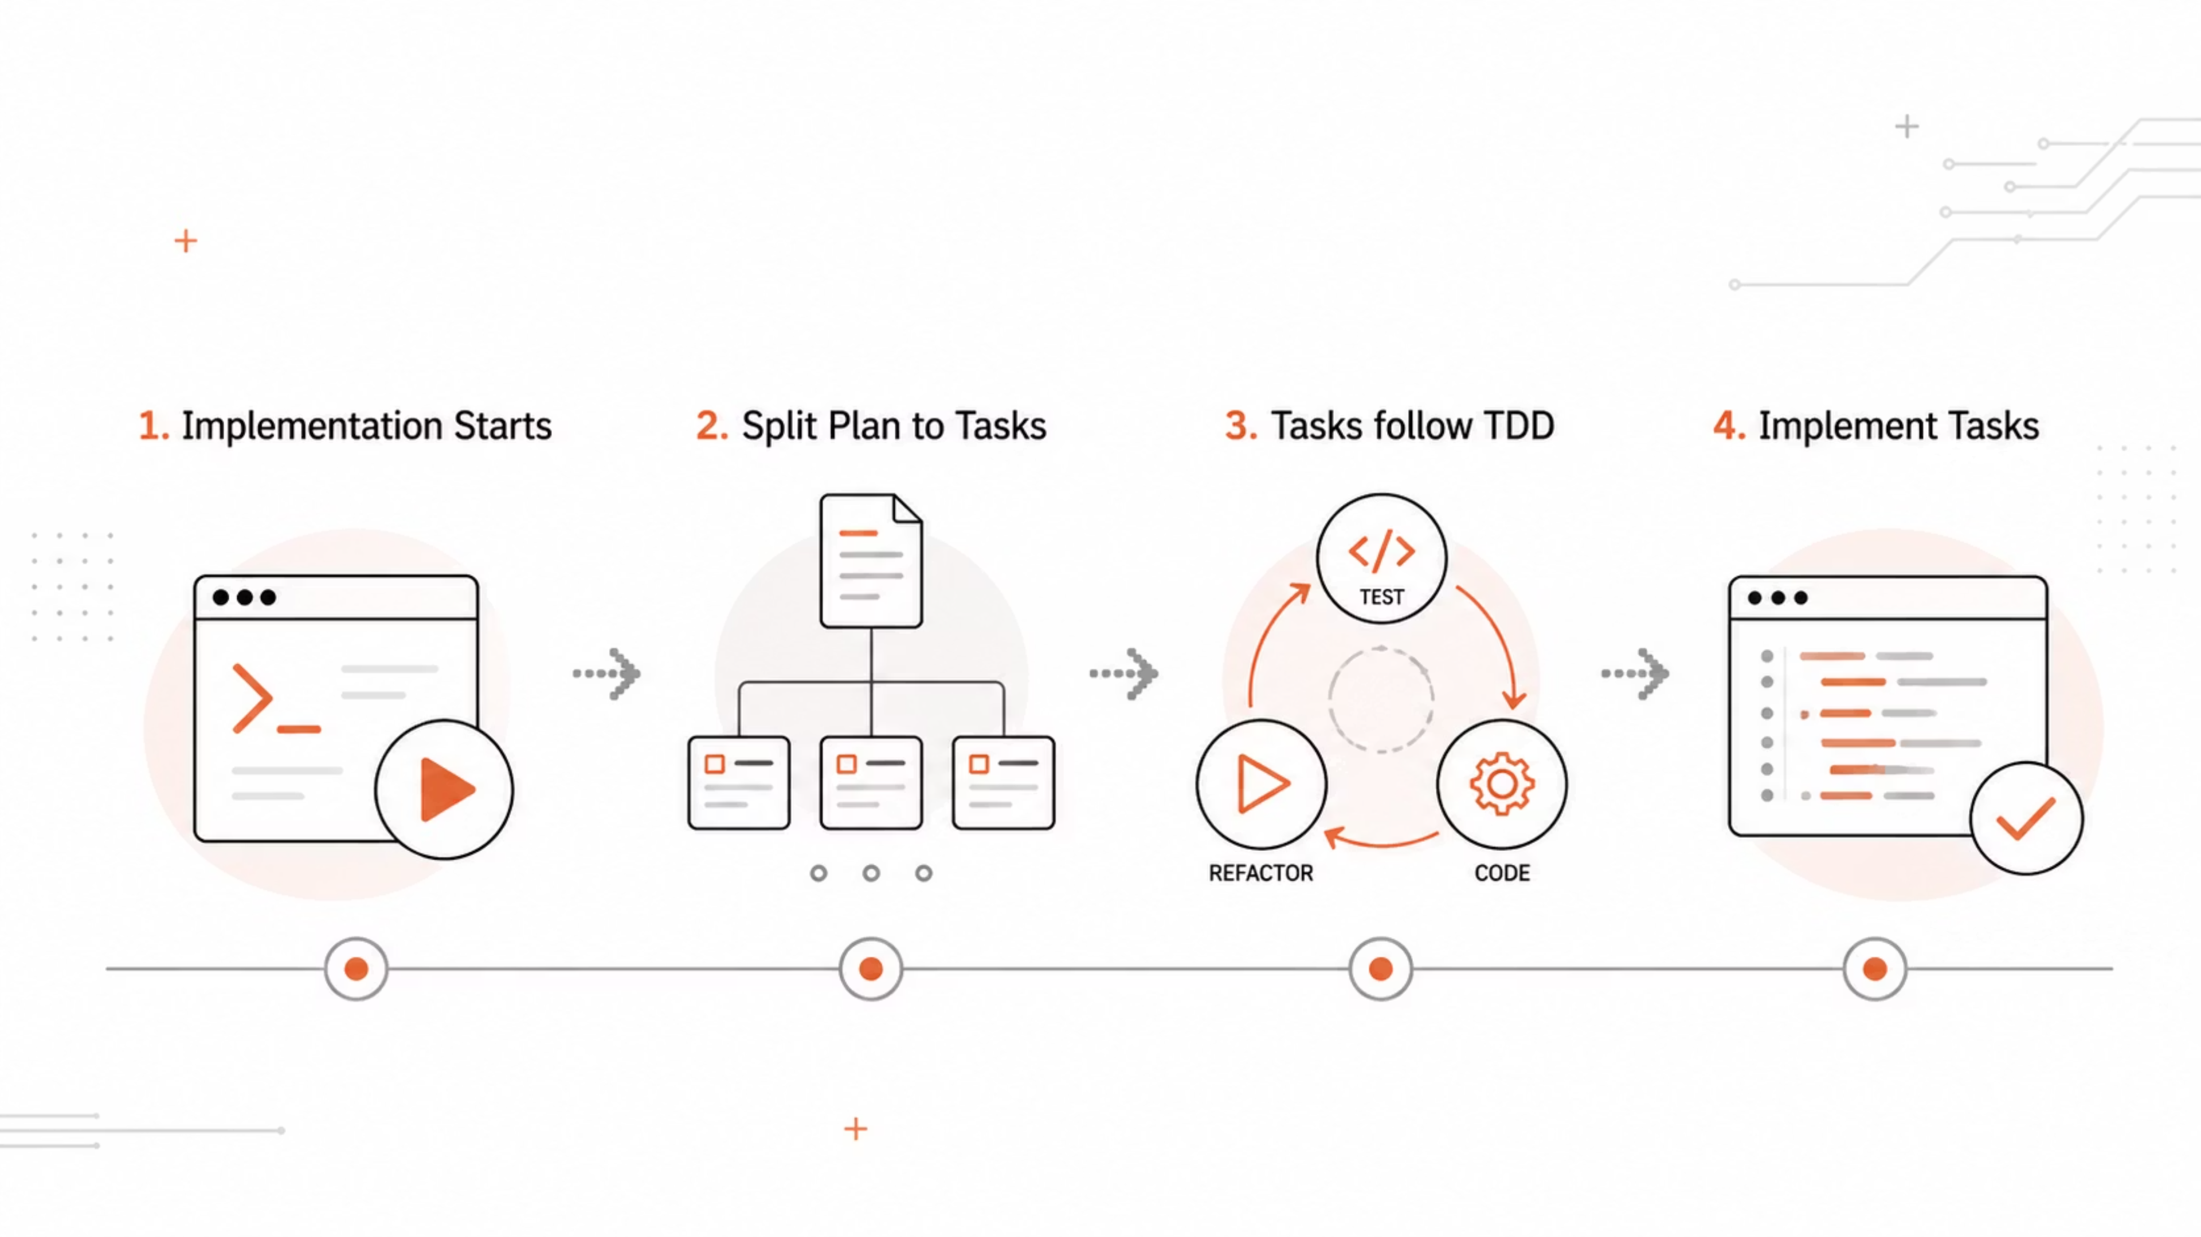

Slide 15
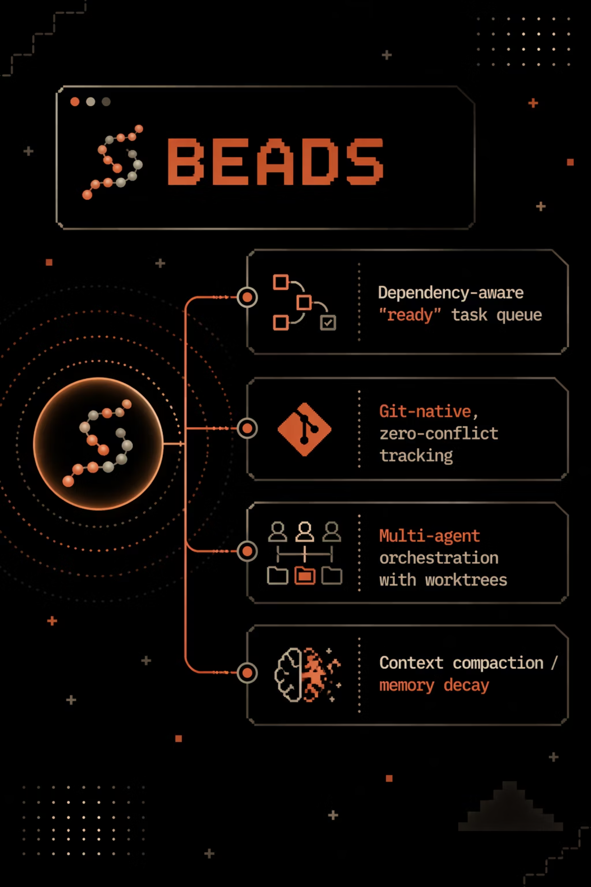
Beads
Persistent memory across sessions
Dependency-aware "ready" task queue
Git-native, zero-conflict tracking
Multi-agent orchestration with worktrees
Context compaction / memory decay
gastownhall/beads
Notes:
Persistent memory across sessions Claude Code forgets everything between sessions — Steve Yegge calls this the "50 First Dates" problem. Beads gives the agent structured, persistent memory that lives in git alongside your code, so yesterday's work, decisions, and progress are still there tomorrow.
Dependency-aware "ready" task queue Most task systems hand the agent a flat list. Beads tracks dependencies between tasks and exposes a bd ready command that only returns work with no unresolved blockers. Claude picks from that list and nothing else — no wasted effort on blocked work, no guessing what to do next.
Git-native, zero-conflict tracking Issues are stored as JSONL files in .beads/, versioned and merged like code. Tasks use hash-based IDs (e.g., bd-a1b2) instead of sequential numbers, which prevents merge collisions when multiple agents or branches create tasks in parallel. No central server — git IS the database.
Multi-agent orchestration with worktrees Beads pairs naturally with Claude Code's multi-agent patterns. Each task gets its own isolated git worktree (.worktrees/bd-{ID}/), so a supervisor agent can implement a fix without touching main. Multiple agents can work in parallel without stepping on each other, and every change is traceable back to a specific bead.
Context compaction / memory decay As projects grow, closed issues pile up and eat context window. Beads supports "agentic memory decay": after ~30 days, closed tasks are semantically summarized by the agent, keeping the essential context but shrinking the footprint. Originals remain recoverable from git history if you ever need them.

Slide 16



TDD - Red-Green-Refactor
Green
Minimal code
Red
Failing test first
Refactor
Clean code, tests stay green

Slide 17
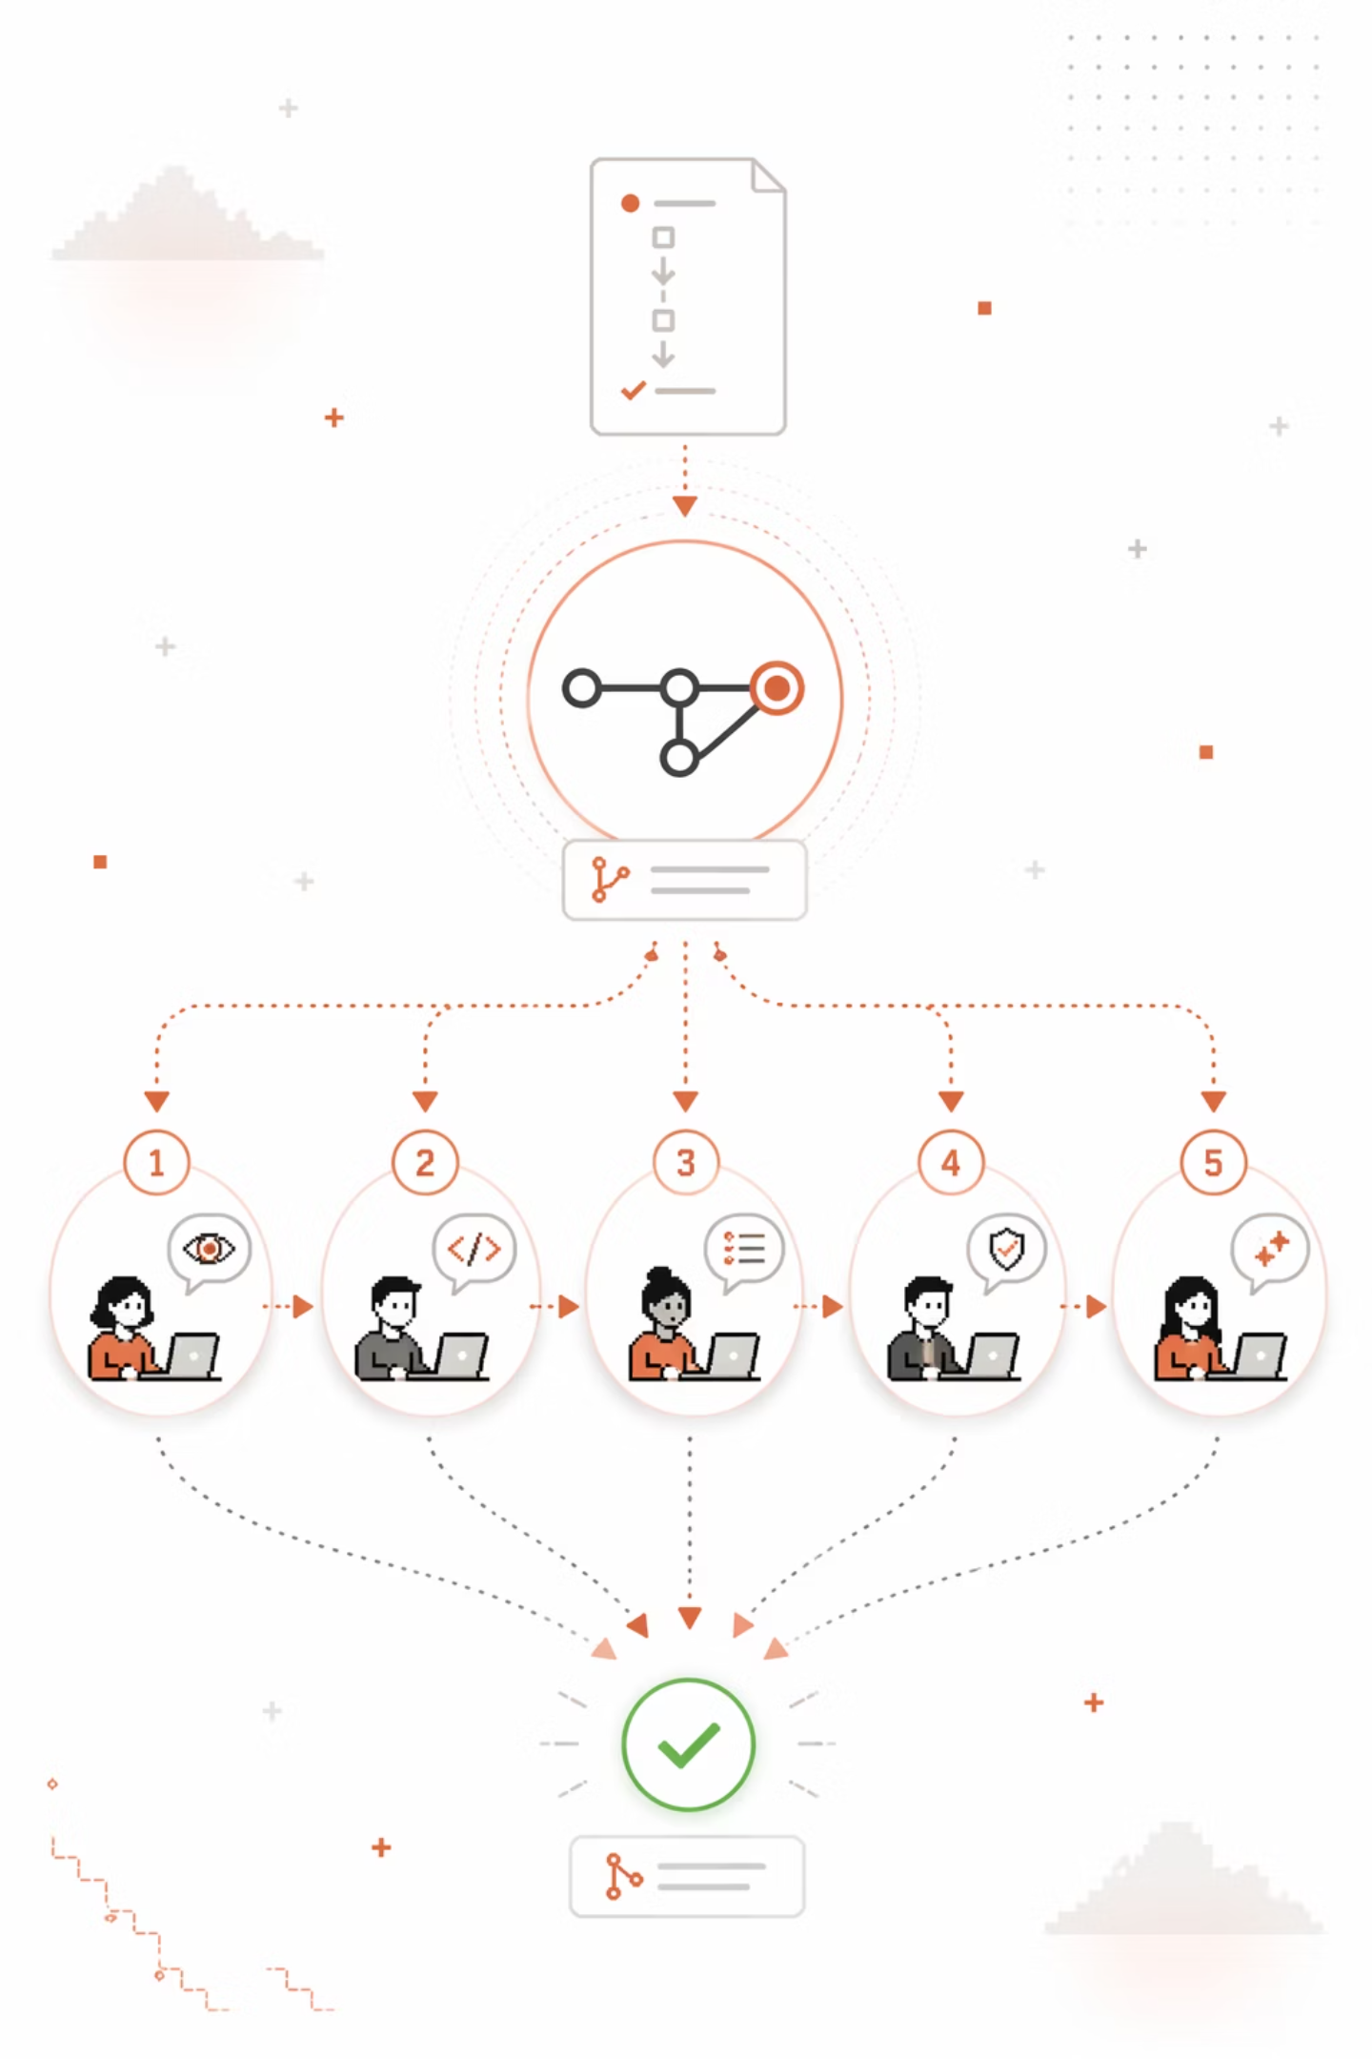
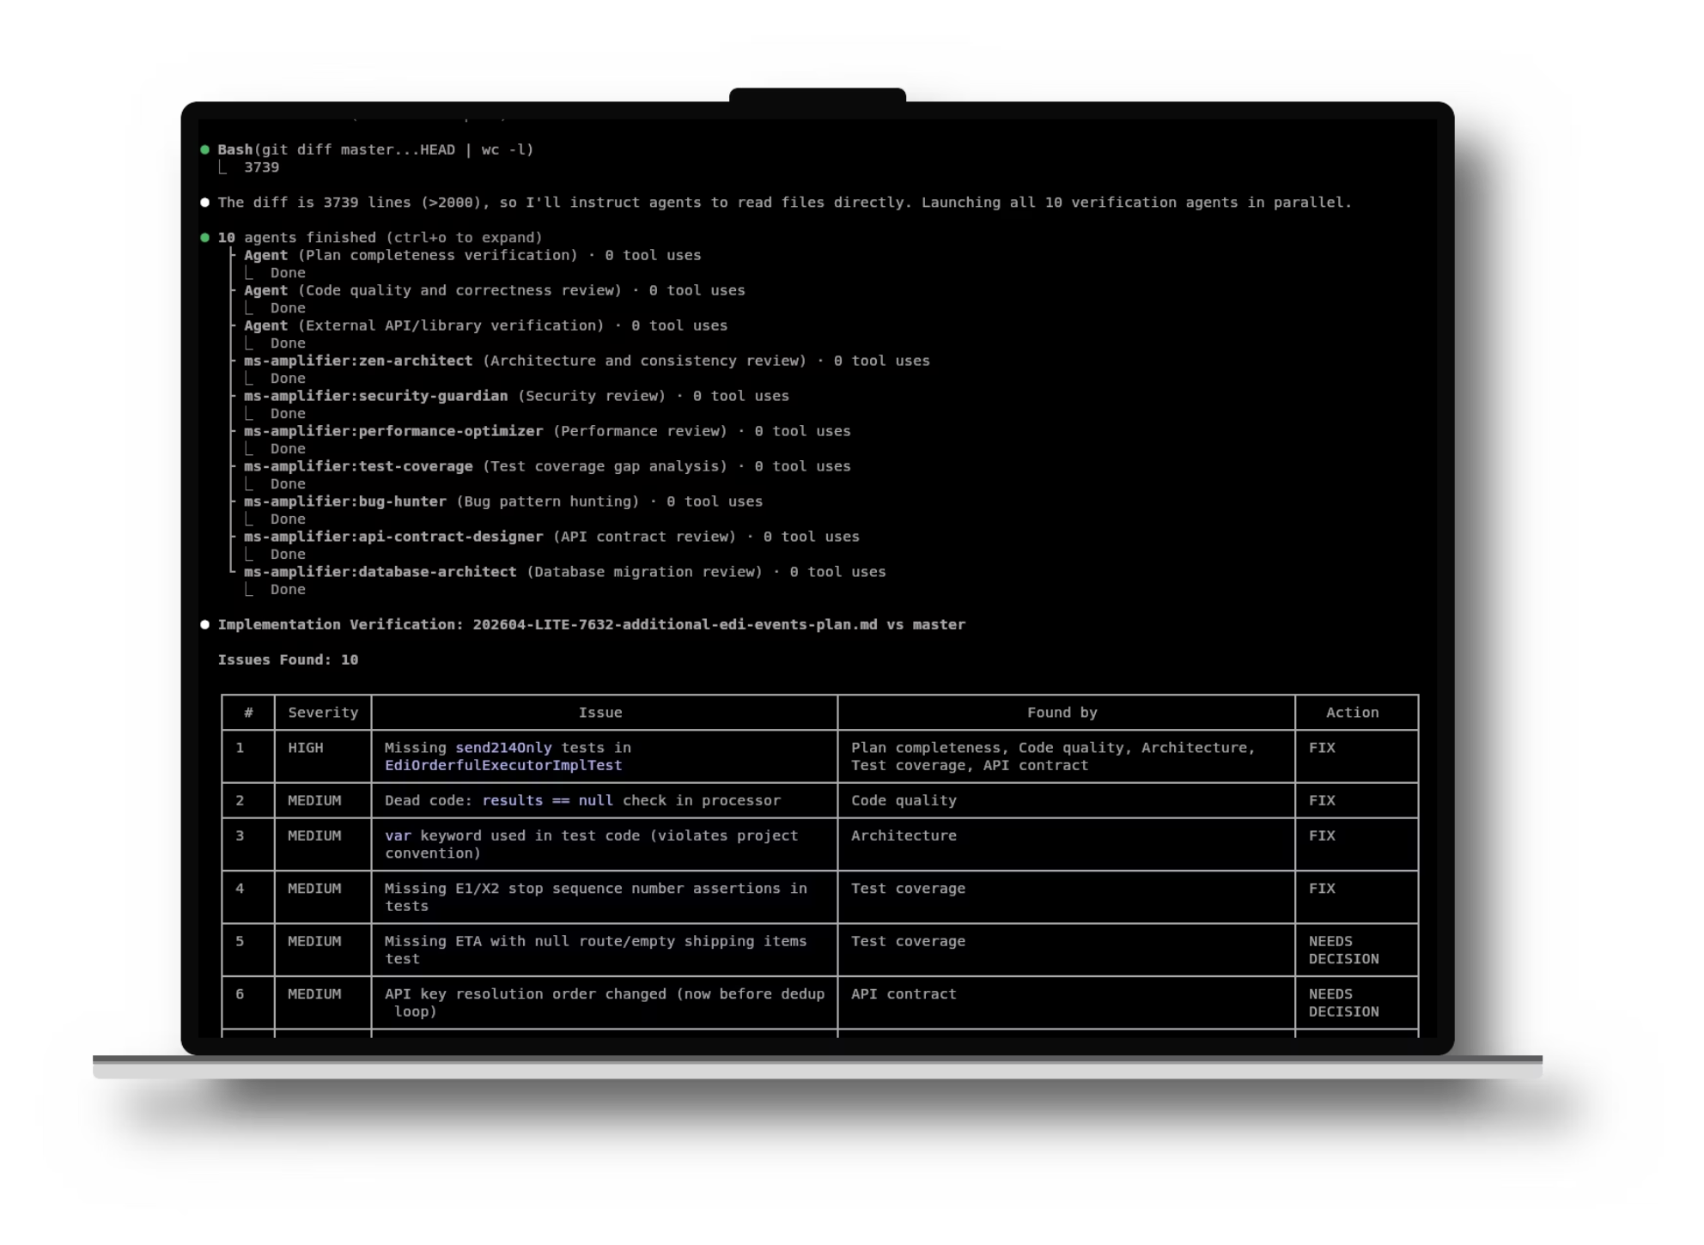

Slide 18
Full SDLC Automation Workflow
Create GIT Branch/Worktree
Build Plan Context
Split Plan in Tasks
Implement Tasks with TDD
Run Tests & Verification
Submit PR for Review

Slide 19
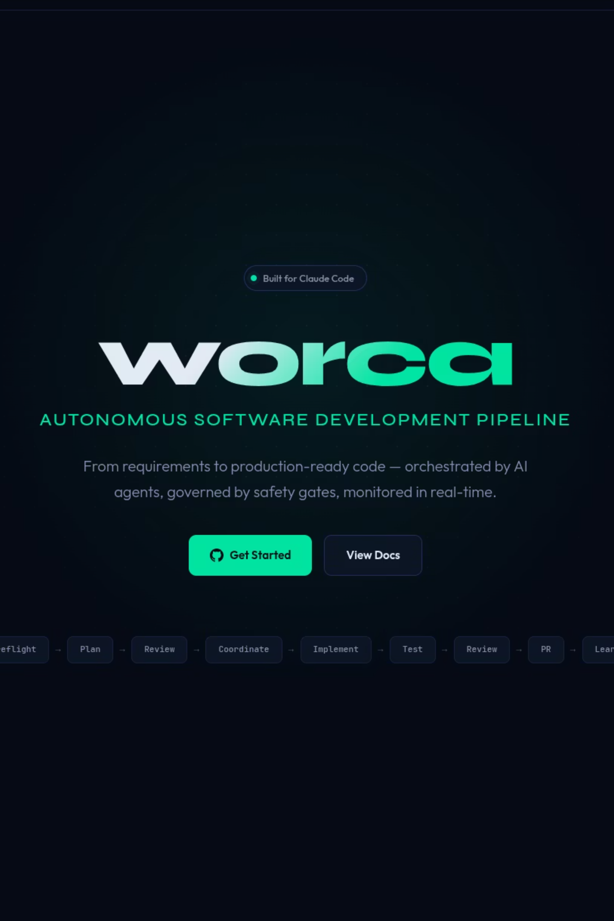
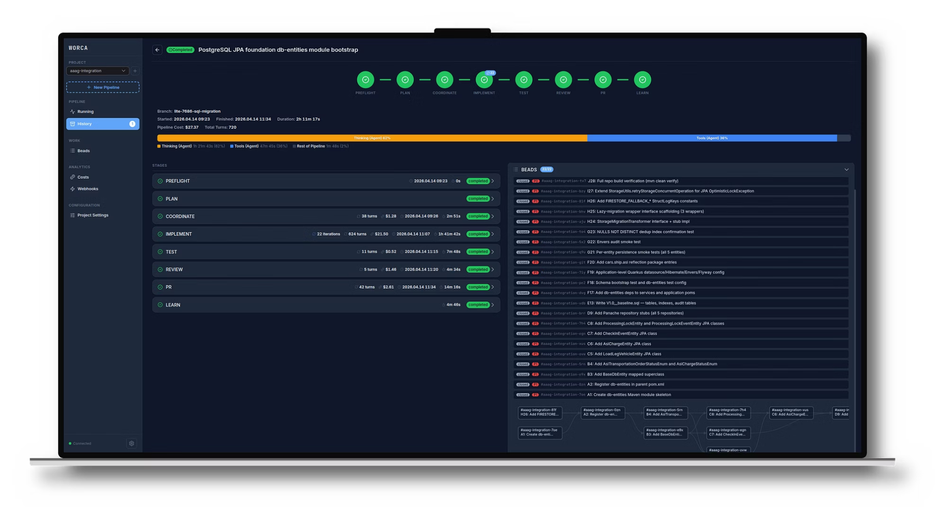
Notes:
https://worca.dev/https://github.com/SinishaDjukic/worca-cc

Slide 20
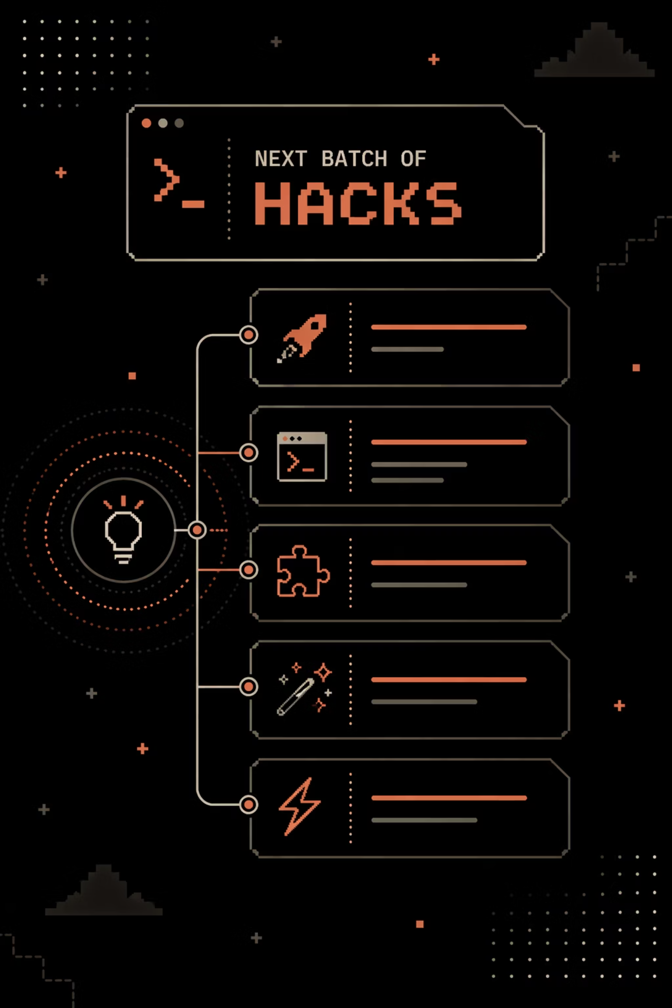
More Hacks

Slide 21
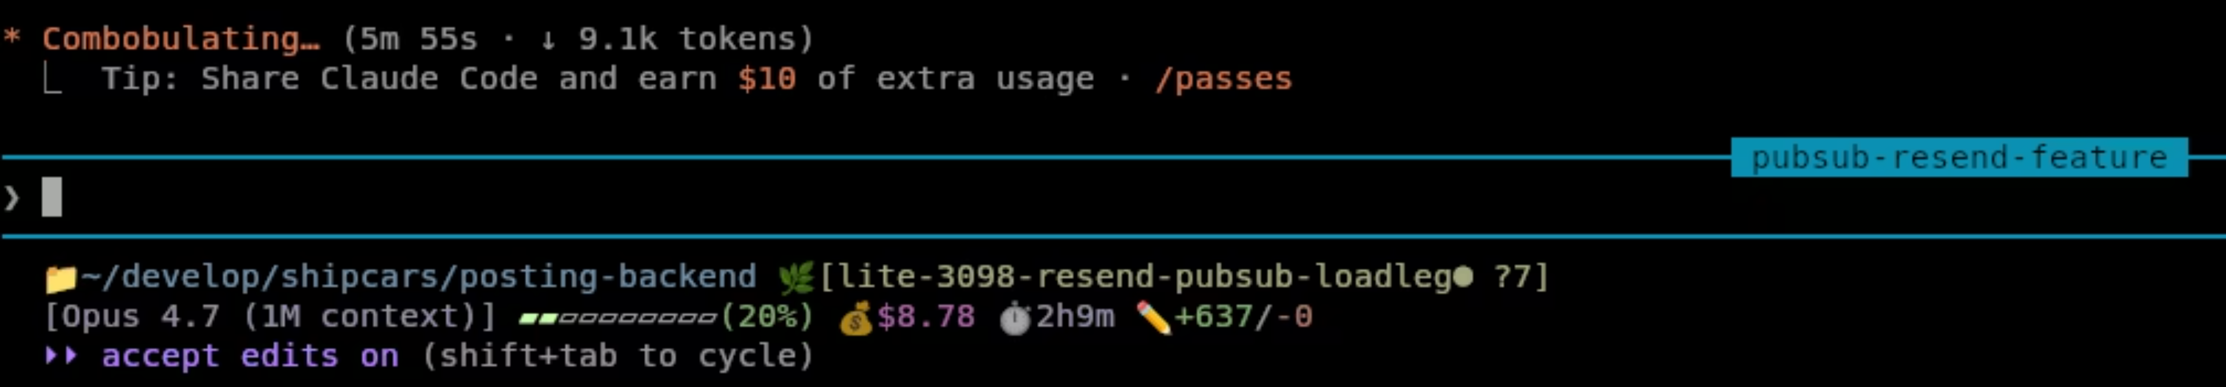
Do Session Rename
Use Status Lines
Use GIT for
User Claude Config
RTK
Reduce bash Context
Notes:
Rename your big plan/impl sessions.Add in the status line helper info.https://github.com/rtk-ai/rtk

Slide 22
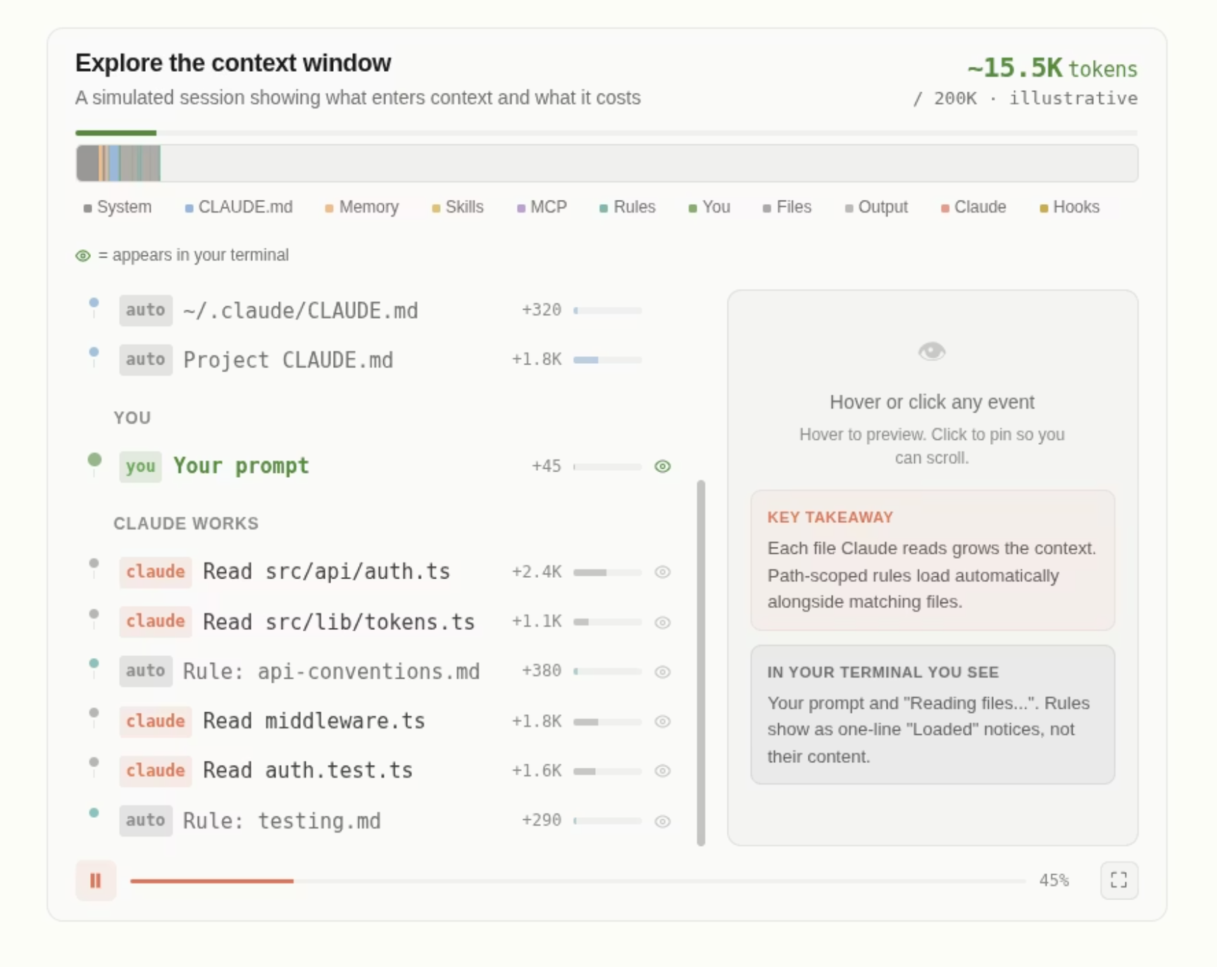
Claude CodeContext Window Insights
https://code.claude.com/docs/en/context-window

Slide 23


