Slide 1
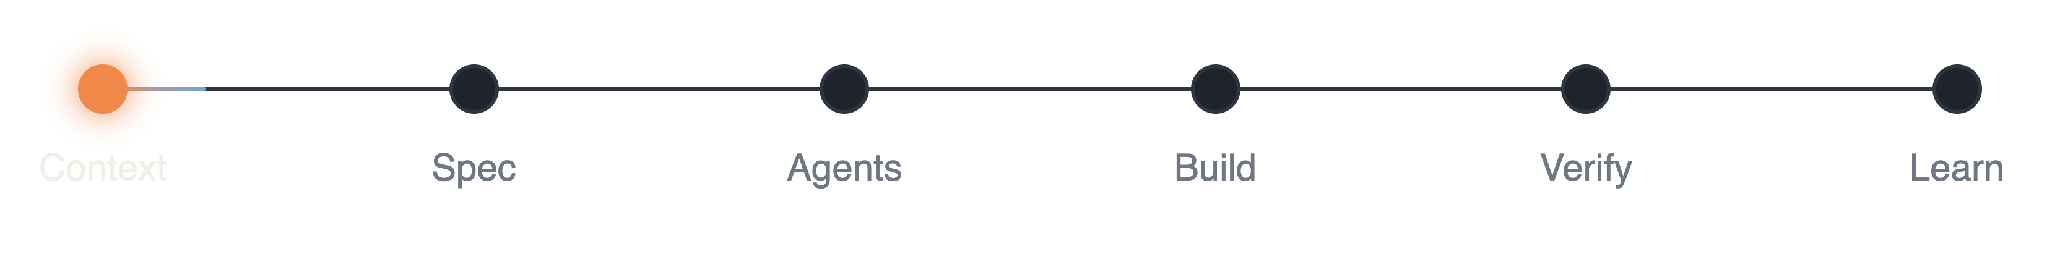
Coding with AI Agents
AI WORKSHOP · 2026
One workflow for Claude Code and Copilot
Ivan Dachev · October 2026
Notes:
Goal of the workshop: one practical, repeatable workflow for coding with AI agents. Everything here is calibrated to Anthropic’s current guidance for modern coding models (prompting guides on platform.claude.com, the Claude Code best-practices docs, and the claude.dev playbooks from September–October 2026). The workflow is tool-agnostic: the same base works for Claude Code and Copilot users.

Slide 2
New models: less prompting, not more
WHAT CHANGED
medium
hours
500K / 1M
Start at medium effort. Go higher only with a measured gain
Long autonomous runs, given a clear finish line
Max context, depending on the model. Thinking built in
Delete from prompts:
think carefully
double-check your answer
use a subagent to verify
Source: Anthropic prompting guides for current models (platform.claude.com)
Notes:
These habits apply to current frontier coding models in general, not to one model. Effort is the main control: start at medium, set it explicitly, and step up only where your own evals show a gain (in Anthropic’s testing Opus 5.5 at medium matched Opus 5 at high). Current models handle long multi-step work for hours when they know what “done” looks like. Context windows are 500K to 1M tokens depending on the model, and thinking is built in, so “think carefully” lines add latency without improving quality. Models also verify and self-correct on their own, so explicit “double-check” or “use a subagent to verify” instructions cause over-verification and should be removed.

Slide 3
Three habits for every session
TRY THIS FIRST
01
02
03
Whole task. Clear finish line.
Turn the effort dial. Skip “think hard”.
Read “needs your decision” first.
“Done means: every endpoint migrated, old client deleted, tests pass.”
Modern models always think. Effort decides how much.
Short IDs on every question, so you answer “Q2 yes, OP1 no”.
Source: claude.dev playbooks · Best practices for Claude Code
Notes:
The three things Anthropic’s Opus 5.5 playbook says to try first. One: give the whole task in one message, name the finish line, say when it should stop and ask, then let it work. Opus 5.5 keeps going on long multi-part work better than Opus 5. Two: delete “think carefully / step by step” lines from prompts and saved instructions; to change how much it thinks, change effort. For a quick answer say “Answer directly.” Three: when a long run ends, read what it needs from you first (open decisions, approvals), then the rest. You can fix the summary format in CLAUDE.md. Lesson from our sessions: design answers for a 10-second read. Give every question, option and open point a short ID (Q1, OP2) so the human answers “OP2 yes, Q3 no” instead of quoting text; separate “needs your decision” from “for your information”; report progress as a percentage of the agreed plan, not as a story.

Slide 4

Ten steps, one loop
THE WORKFLOW
1
01
Context files
short, with a stop rule
10
2
Skills, MCP, plugins
02
on demand, few tools
03
Jira and GitHub
ticket to PR, least privilege
9
3
04
Spec and review
SPEC.md with a finish line
Step 8 feeds step 1
05
Agents and advisor
parallel, observer watches
06
Build
effort dial, tests first
8
4
07
Verify
green ≠ verified, layered review
08
Learn
repeated fix becomes a rule
7
5
09
Marketplace
owner and version per plugin
6
10
Copilot parity
AGENTS.md as the shared base
Notes:
The whole workflow on one loop. Each key press reveals the next step: its circle on the ring and its line on the right, steps 1 to 6 in orange (set up, plan, build) and 7 to 10 in blue (verify, learn, scale). The last press shows the centre label. Order calibrated to Anthropic’s guidance: set up the context first (CLAUDE.md / AGENTS.md, skills, MCP, connectors), then spec, then build and verify, then learn and package. The loop closes because what you learn in step 8 goes back into the context files and skills of step 1.

Slide 5


Context files: short and sharp
STEP 01 · CONTEXT FILES
Keep
Cut
Commands Claude can’t guess
What the code already shows
Rules that differ from defaults
Long docs: link them with @import
Architecture rules and “never do”
“Write clean code”
Test runner and repo etiquette
“Think carefully”
Test each line: would removing it cause a mistake? No: cut it.
Source: Best practices for Claude Code (code.claude.com/docs)
Notes:
Anthropic’s rule for CLAUDE.md: keep it short and human-readable, because it loads every session and a bloated file makes Claude ignore the rules that matter. Start with /init, then prune. For every line ask whether removing it would cause Claude to make a mistake; if not, cut it or turn it into a hook. Include commands it can’t guess, style rules that differ from defaults, test instructions, repo etiquette, architecture decisions and gotchas. Exclude what Claude can read from the code, standard conventions, detailed API docs (link them with @path imports), frequently changing info and self-evident advice. Use emphasis like IMPORTANT on one line only. /doctor proposes cuts for a checked-in CLAUDE.md. Nested per-module files help in monorepos. For Opus 5.5 also remove “think carefully” lines.

Slide 6
Tell it when to stop
STEP 01 · THE ONE RULE TO ADD
KEEP GOING
# CLAUDE.md · stop rule
When nothing needs you
When a step doesn’t need my input, keep going.
Status notes go with your next action.
Stop and ask only when you can’t go on without me,
STOP AND ASK
Blocked, or destructive
or before anything destructive: deleting data,
force-pushing, touching files outside this repo.
Report: Needs your decision (Q1, Q2…) · FYI
UNATTENDED
Progress as % of plan. Commands alone in code blocks.
Prod, deploy, push: your explicit yes
Source: claude.dev playbook · Anthropic prompting guides, unattended agentic runs
Notes:
Opus 5.5 keeps you posted while it works, and on long tasks it sometimes stops to report: a summary that names the next step without taking it, an offer to continue, or a list of non-blocking choices. Anthropic’s fix is a short rule in CLAUDE.md that names which stops you want and which you don’t. Adapt the wording to your project. Because the rule means fewer stops, keep your own checks before anything risky, and keep permission prompts on for destructive commands. For pair programming you may want the opposite: a one-line plan before starting and a short recap at the end. The last lines fix the report format: decisions first with short IDs, then FYI, progress as a percentage of the plan, and every copy-paste command alone in a code block. Lessons from our sessions for unattended runs: a permission prompt silently blocks an agent for as long as nobody answers, so give unattended reviewers read-only tools. Every production write, deploy and push needs an explicit yes, every time; one approval does not cover the next. Personal permissions go in local, uncommitted settings, never in shared config. Deletion is three steps: list, independent check, delete. A manual change on a live system must also go into the source of truth, or the next deploy reverts it. Notify the human’s phone only after a real absence.

Slide 7






Context is the scarce resource
STEP 02 · SKILLS, MCP, PLUGINS
CLAUDE.md
Skills
Hooks
Subagents
MCP
Every session
Loaded when relevant
Every time, enforced
Their own context
Tool defs use context
Prefer CLI tools (gh, gcloud) · Vet every plugin like a package
Source: Best practices for Claude Code · Extend Claude Code (code.claude.com/docs)
Notes:
Anthropic’s core constraint: the context window fills fast and performance degrades as it fills. Each extension type costs context differently. CLAUDE.md loads every session, so keep it to what always applies. Skills load on demand, which is where domain knowledge and repeatable workflows belong. Hooks are deterministic: use them for anything that must happen every time with zero exceptions, such as lint after each edit or blocking writes to migrations. Subagents run in their own context and report back summaries. MCP servers add tool definitions to the context, so enable per project, not globally. CLI tools such as gh are the most context-efficient way to reach external services. For typed languages, install a code-intelligence plugin. Plugins and mods run with Claude Code’s access on your machine: read the repo first and install only from publishers you trust. Examples from your stack: superpowers, Serena.

Slide 8






From ticket to pull request
STEP 03 · JIRA AND GITHUB
Jira ticket
SPEC.md
Branch
PR + AI review
Ticket updated
AGENT MAY
HUMAN APPROVES
Read tickets and code, comment, draft the PR
Merge, status changes, anything destructive
CLI first (gh). MCP where there is no CLI.
Least-privilege tokens. Read-only by default.
Source: Best practices for Claude Code, CLI tools and MCP · claude.dev, How the Claude Code team does code review
Notes:
Connect the tools in the order the work flows: the Jira ticket becomes a spec, the spec becomes a branch (a git worktree when agents run in parallel), the branch becomes a PR with an AI review, and the PR links back to the ticket. Anthropic recommends CLI tools such as gh as the most context-efficient way to reach external services; use MCP servers (Jira/Atlassian, Figma, databases) where there is no good CLI. Decide up front what the agent may do alone (read, comment, draft PRs) and what a person approves (merge, ticket status, anything destructive). Use least-privilege tokens. Opus 5.5 resists prompt injection from tool results better than earlier models, but ticket and web content is still untrusted input.

Slide 9

Spec before code
STEP 04 · PLANNING AND SPECIFICATION
1 · Explore
2 · Plan
3 · Implement
4 · Commit
Plan mode: reads, asks, changes nothing
1 · Claude interviews you
SPEC.md
Goal and finish line: “Done means…”
2 · It writes SPEC.md
Files, interfaces, layers involved
Out of scope
3 · A fresh session builds it
Tests and an end-to-end check
One-sentence diff? Skip the plan.
When to stop and ask
Source: Best practices for Claude Code, Explore, plan, code and Let Claude interview you
Notes:
Anthropic’s recommended flow is explore, plan, implement, commit. Explore and plan in plan mode, which reads files and answers questions without making changes; Ctrl+G opens the plan in your editor so you can trim it before Claude proceeds. For larger features, start with a minimal prompt and ask Claude to interview you with the AskUserQuestion tool about implementation, edge cases and trade-offs, then write a complete SPEC.md. Then start a fresh session to execute it. The most useful specs are self-contained: they name the files and interfaces, state what is out of scope, and end with an end-to-end verification step. Add the Opus 5.5 finish line (“Done means…”) and when to stop and ask. Planning adds overhead: if you can describe the diff in one sentence, skip it. Keep your existing hints: let the agent assess repo scope first, one spec per product area, split cross-repo specs explicitly, trim over-engineered plans, review the spec in a fresh session.

Slide 10
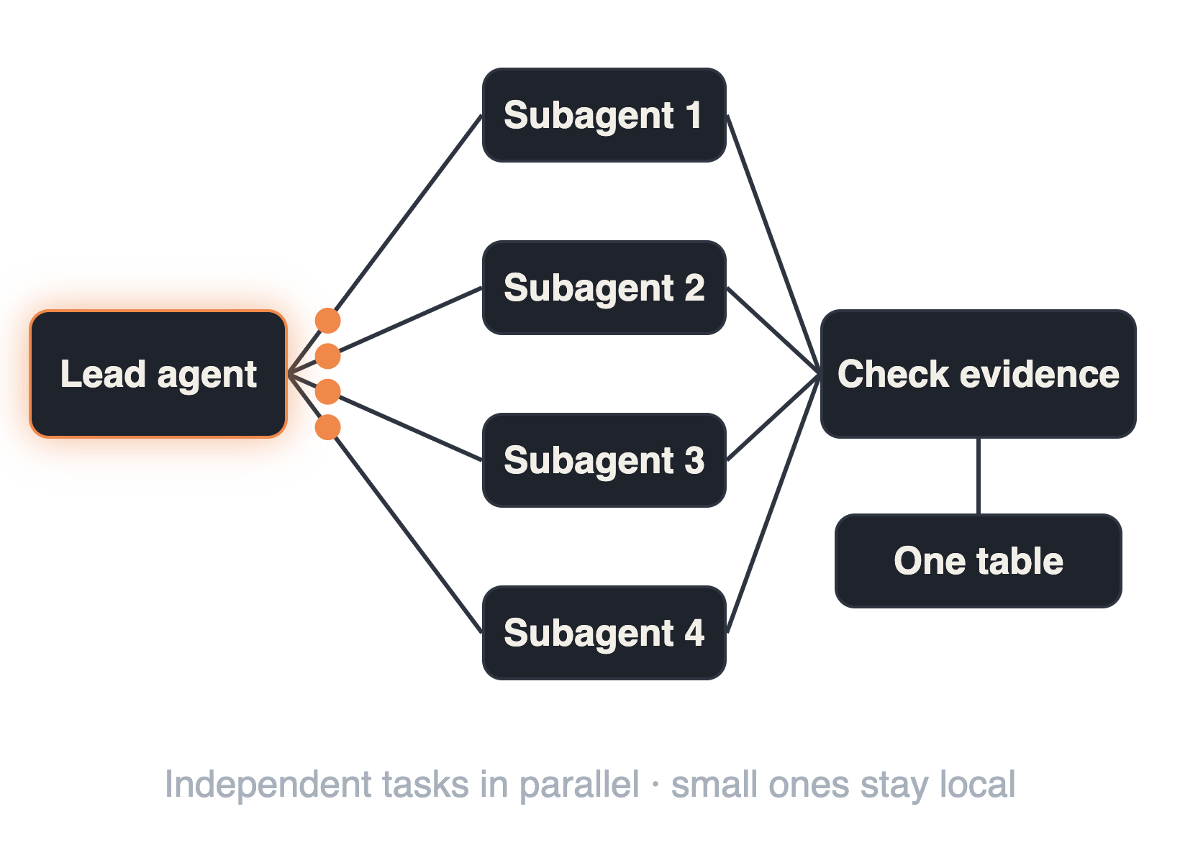
Delegate big work, check evidence
STEP 05 · AGENTS, SUBAGENTS, ADVISOR
ADVISOR
Second opinion at decisions
/advisor opus
Fast main model + stronger advisor · same-tier advisor for high stakes
OBSERVER
A second agent watches
Catches silent decisions and false success
Unasked behavior change = a question
Source: Anthropic prompting guides, subagent spawning · claude.dev playbook · Claude Code docs, advisor tool
Notes:
Subagents: Opus 5 delegates to subagents more readily than earlier models. Delegation pays off on large, genuinely independent work (a wide audit, a migration across services) and multiplies cost on small tasks. Tell it to use one subagent if one is enough and never to use subagents just to double-check itself; hard caps are CLAUDE_CODE_MAX_SUBAGENT_SPAWN_DEPTH and CLAUDE_CODE_MAX_CONCURRENT_SUBAGENTS. The Opus 5.5 playbook pattern: give each service its own subagent, check each one’s evidence before accepting it, finish with one table. Advisor: /advisor (or the advisorModel setting, or claude --advisor) lets the main model consult a stronger model at decision points: before committing to an approach, on a recurring error, before declaring done. Common pairings: Sonnet main + Opus advisor for everyday work; Opus + Opus (or Fable, with access) for high-stakes changes. It is experimental and Anthropic-API only (not Bedrock or Vertex). Related: opusplan uses Opus in plan mode and Sonnet for execution. Sessions: writer and reviewer in separate contexts; worktrees keep parallel agents from colliding. Lessons from our sessions. Parallel by default: after the spec, split the work and start independent tasks (and ones with small merge conflicts) at the same time; small tasks stay in the main agent. Observer agent: a second agent that only watches the main one catches what tests are not built to catch: silent product decisions, a script reporting success when its query failed, permissions leaking into shared config, only part of the input processed, work started before an open question was answered, manual changes on a live system that never reached the source of truth. Rule: a behavior change nobody asked for is a question, not a decision. A second agent is cheap compared with the bugs it catches. Model by task: strongest model for hard code, refactoring and review; a cheaper one for tests, scripts and mechanical work; a reviewer from another provider finds different defects.

Slide 11

Effort dial, not “think hard”
STEPS 05–06 · MODEL SETTINGS
Level | Use it for
low | Quick edits, first review pass
medium | Default. Most coding work
high | Hard, ambiguous changes
xhigh / max | Only with a measured gain
Less thinking? Lower effort first.
Model by task: strongest for hard code and review, cheaper for tests and scripts
Source: Anthropic prompting guides, Calibrate effort and Efficiency at lower effort
Notes:
Effort is the main control for how much Opus 5.5 thinks, because thinking is always on. Start at medium (the Opus 5.5 default; Opus 5 defaults to high), set it explicitly, and test several levels on your own tasks rather than carrying over your Opus 5 setting. Level names don’t mean the same amount of thinking across models: at medium Opus 5.5 matches or beats Opus 5 at high, and on several coding evaluations low comes close at much lower cost. At the same named level Opus 5.5 thinks more per turn than Opus 5, especially at xhigh and max, so reserve those for work where you measured a gain. To get less thinking, lower effort rather than adding prompt instructions. Code review accuracy holds at low effort, so a fast low-effort pass plus a deeper pass later is a good pattern. For API integrations, thinking counts toward max_tokens; 128,000 has worked well for long agentic coding turns. The high and low rows in the table are our suggested usage; the medium default and the xhigh/max guidance are Anthropic’s. Lesson from our sessions: pick the model by task. Strongest model for hard code, refactoring and review; a cheaper one for running tests, scripts and mechanical work; not the smallest model for timing-sensitive checks (it reported failures that were not real). The human sets model and effort up front, and the agent keeps them for the whole session.

Slide 12



Give it a check it can run
STEP 06 · IMPLEMENTATION
Tests first
No test edits without approval
TASKS.md
Survives compaction. No TODO without evidence
Hooks and /goal
Per change: lint and touched tests. Full suite per batch
Fresh session
After two misses or a full context. Point to docs
Source: Best practices for Claude Code, Give Claude a way to verify its work · claude.dev playbook
Notes:
Anthropic calls this the most important practice: give Claude something that returns pass or fail, such as tests, a build, a linter or a screenshot to compare, and have it show the evidence (test output, the command and its result) instead of saying it is done. Boris Cherny estimates it makes the result two to three times better. Ways to gate “done”: ask in the prompt; set a /goal condition that a separate evaluator re-checks after every turn; or a Stop hook that blocks the turn from ending until the check passes. Write tests first and confirm they fail; the agent must not change tests to make them pass without approval. For long runs keep the task list in TASKS.md, which survives compaction and shows progress at a glance. Hooks are deterministic, unlike CLAUDE.md. If you corrected Claude twice on the same issue, /clear and start again with a better prompt. You can add to a running task by typing while it works. Use git worktrees for parallel agents. Lessons from our sessions. Green does not mean verified: check how many tests were skipped and why; exit code 0 is not proof, and an empty result first means “check the command didn’t fail”; test fakes only replay your assumptions, so run one check against the real dependency; never conclude something “does not exist” without checking; try every visible change in the running app and give the human a list of use cases to test by hand in parallel. A TODO needs evidence (a concrete input, a failing test or an observed failure) and one clear reason to wait; in our sample only about 30% of deferred TODOs were really needed and about half could have been done at once. With many agents in parallel, each runs lint, type check and the tests of the files it touched; the full suite runs once per merged batch and always before a push. Time box: finish all work that fits, about 30% over is fine. Context is a budget: stop long-running subagents at a clean boundary and start a fresh one with a short prompt; hand over a full main session with a prompt that points to the docs instead of copying them.

Slide 13

Review in layers, not one gate
STEP 07 · VERIFICATION AND CODE REVIEW
2×
More merged pull requests
−40%
Share of PRs reverted
Claude Code team, June to September 2026
Source: How the Claude Code team does code review (claude.dev, Oct 2026)
Notes:
How Anthropic’s Claude Code team reviews code at agent volume: merged PRs more than doubled from June to September while the share that had to be reverted fell by more than 40%. They didn’t remove review; they moved most reading to machines and made mistakes fast to undo. Layers: 1) before the PR, Claude runs tests, build and lint and a second agent reviews the diff in a fresh context (/code-review, /security-review locally); 2) required CI, where our architecture fitness tests (e.g. ArchUnit) belong; 3) AI review on every PR, with findings verified by other agents and every thread answered; 4) a separate security review that can block; 5) human approval scaled by risk; 6) merge queue, feature flags, staged release, fast rollback. Each layer misses some problems; few get through all of them. Practical extras: a short REVIEW.md written by code owners, a PR template with Testing, Risk and How to revert, and a cap of about three review rounds, re-reviewing only the new diff after that. When asking Claude to review, ask it to report everything it would block the merge for, with file, line and how to show it fails; avoid “only high severity”, which it follows literally. Lessons from our sessions: check every review finding against the real code before fixing it, and report the rejected ones too, because reviews produce plausible but wrong findings. A second review from a model of another provider finds different defects than two reviews from the same one.

Slide 14
People where the risk is
STEP 07 · HUMAN REVIEW
0
1
2
HUMANS, ONCE CHECKS ARE GREEN
HUMAN APPROVAL
HUMAN APPROVALS
Medium risk
High risk
Low risk
Ordinary product changes
The riskiest paths you name: auth, billing, CI
Docs, copy, additive changes behind a flag
The change sets the tier, not the author
Whoever prompted the change owns it
A bot approval never replaces a human one
Source: How the Claude Code team does code review (claude.dev, Oct 2026)
Notes:
Anthropic’s Claude Code team scales human approval by risk. Low risk (docs, copy, internal features, additive changes behind a flag): no human approval once automated and security review are green, and only for trusted authors. Medium (ordinary product changes and sensitive areas): one person. High (the riskiest code plus a few paths that always need two people): two. A classifier reads the change and sets the tier; the author doesn’t. CODEOWNERS and branch protection keep auth, billing, CI/release workflows and installers behind a person. On an agent-written PR the person directing the agent counts as a required reviewer. A bot’s approval never fills a human slot, and approvals are dismissed when new commits land. Humans stay responsible for: whether to build it at all, risky code, architecture that sets a pattern, reading the evidence, and owning the outcome. Start strict and loosen with evidence; track reverts and incidents as the guardrail.

Slide 15






Fix it once, at the source
STEP 08 · SELF-LEARNING
Repeated correction
Fix at the source
Prune and test
“I said this twice already”
Trap · why · how to apply
Did the behavior change?
PUT IT IN
CLAUDE.md
a skill
a hook
a lint rule
REVIEW.md
Incidents and reverts become evals
/doctor proposes CLAUDE.md cuts
Source: Best practices for Claude Code · How the Claude Code team does code review (claude.dev)
Notes:
The self-learning loop. After each session, a short retro: what did I correct more than once? Don’t fix it in the next prompt; fix it at the source so it never repeats. Pick the right home: CLAUDE.md for rules that always apply, a skill for knowledge or workflows needed only sometimes, a hook when it must happen every time with no exceptions, a lint rule when a tool can enforce it, REVIEW.md when the reviewer keeps missing or over-flagging something. Anthropic says to treat CLAUDE.md like code: review it when things go wrong, prune it regularly, and test changes by watching whether Claude’s behavior actually shifts; /doctor proposes cuts for content Claude can derive from the codebase. The Claude Code team turns past incidents and reverts into an eval set and re-scores the reviewer whenever its prompt, tools or model change. When a review misses something, they ask what the model didn’t have in front of it and add that to CLAUDE.md, a skill or a check. Lessons from our sessions: write a rule when a mistake cost a work cycle, when a fact proved an assumption wrong and will still be true next month, or when the human had to ask for the same thing twice. One topic per short note, in the form trap, why, how to apply. Team rules go in the repository, personal preferences in personal memory. Never store session summaries or restatements of the code; old scratch notes are not a source of truth.

Slide 16



Package what works, share it
STEP 09 · PRIVATE PLUGINS AND MARKETPLACE
acme-workflow/
Skills
Hooks
Marketplace
Team
Subagents
MCP servers
git repo + marketplace.json
/plugin install x@acme
Commands
Mods
Owner + version
claude plugin validate · test
Review it like a package
Source: Claude Code docs, plugins · claude.dev, Getting started with Claude Code mods (Oct 2026)
Notes:
Once the team knows what works, package it. A Claude Code plugin bundles skills, hooks, subagents, slash commands and MCP servers into one installable unit; mods (hooks written in JavaScript or TypeScript that can change behavior and draw UI) ship inside plugins too. A marketplace can be as simple as a git repo with a .claude-plugin/marketplace.json; the team adds it with /plugin marketplace add org/repo and installs with /plugin install name@marketplace. Decide what stays repo-local (CLAUDE.md, project skills) and what becomes company-wide (stack conventions, review rules, deploy flows). Give each plugin an owner and a version, run claude plugin validate and claude plugin test before publishing, and test skills with evals (claude plugin eval). Plugins and mods run with Claude Code’s access on the developer’s machine, so review them like any package dependency.

Slide 17
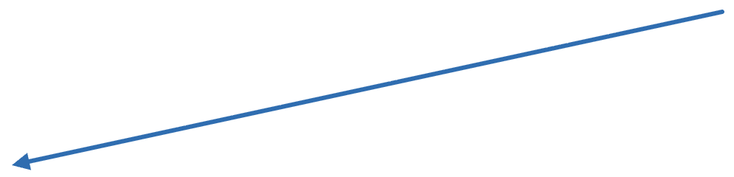

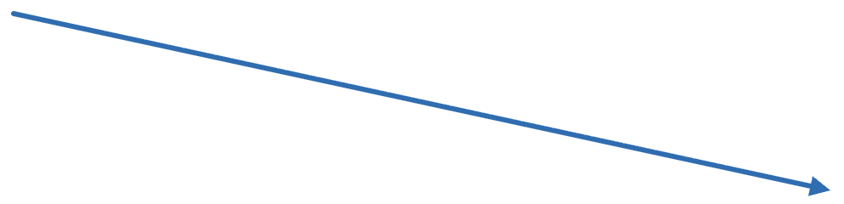
One base for every tool
STEP 10 · COPILOT PARITY
AGENTS.md
Shared rules and commands
Claude Code
Copilot
Modules
CLAUDE.md: @AGENTS.md
copilot-instructions.md
AGENTS.md per package
Same for both: spec, finish line, TDD, layered review
Claude Code extras: advisor, subagents, hooks, /goal, plugins
Source: Claude Code docs, CLAUDE.md imports · claude.dev, Claude Code mods (AGENTS.md support)
Notes:
Team members without Claude Code seats use Copilot, so the shared knowledge lives in AGENTS.md. Claude Code reads AGENTS.md (its AGENTS.md support is built as one of its own mods), and CLAUDE.md can import it with @AGENTS.md and add only Claude-specific lines such as the stop rule. Point Copilot’s instructions file at the same content so both tools follow the same rules. In monorepos, add a short AGENTS.md per package or module. The method is the same for both tools: spec with a finish line, tests first, layered review, a human owns the merge. Claude Code adds the advisor, subagents with caps, deterministic hooks, /goal, and plugins and mods; show the Copilot equivalents your team uses where they exist.

Slide 18










Your checklist
TAKE-HOME
Ask
Long runs
Check
Team
Whole task with a finish line
Stop rule in CLAUDE.md
A check it can run
Repeated asks become written rules
An observer agent beside the main one
No “think hard” lines
Context and permissions set before you leave
No TODO without evidence
Model and effort set up front
Green ≠ verified
AGENTS.md as the shared base
Parallel by default, full suite per batch
Based on the claude.dev checklist and lessons from our own sessions
Notes:
A one-page summary to keep, combining Anthropic’s checklist with the lessons from our sessions. Ask: the task says what done looks like, no “think hard” lines, model and effort set up front and kept for the session. Long runs: CLAUDE.md says when to stop and when to keep going; before you leave an agent alone, think through its context budget and its permissions; independent tasks run in parallel, with lint and touched tests per change and the full suite once per batch and before every push. Check: Claude has a check it can run and shows the evidence; an observer agent watches the main one; green is not verified until skipped tests, exit codes and one real dependency are checked. Team: every repeated request becomes a written rule; no TODO without evidence and a reason to wait; AGENTS.md keeps Claude Code and Copilot users on the same rules. Five to start with tomorrow: an observer agent; no TODO without evidence and finish what fits the time box; parallel work by default with batched full test runs; plan context and permissions before leaving an agent alone; turn every repeated request into a written rule.

Slide 19
Hand over the whole task. Give it a way to check. Own what ships.
IN ONE LINE
Questions?
Notes:
Close with the three ideas that run through the whole workflow: give the agent the whole task with a clear finish line, give it a check it can run so it can verify itself, and keep a person accountable for everything that ships. Then open for questions, and point to the next hands-on session: run one real backlog task through all ten steps.

